Slide 1


Mobility and Sustainability Division
Department of Public Works
District 5 Town Hall
July 22, 2026
Notes:
Good Evening,
Intro

Slide 2

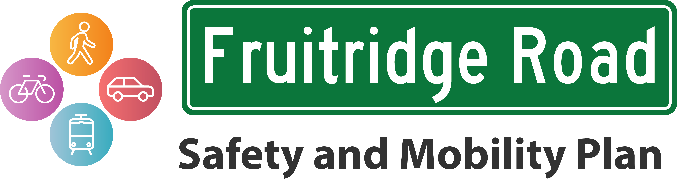
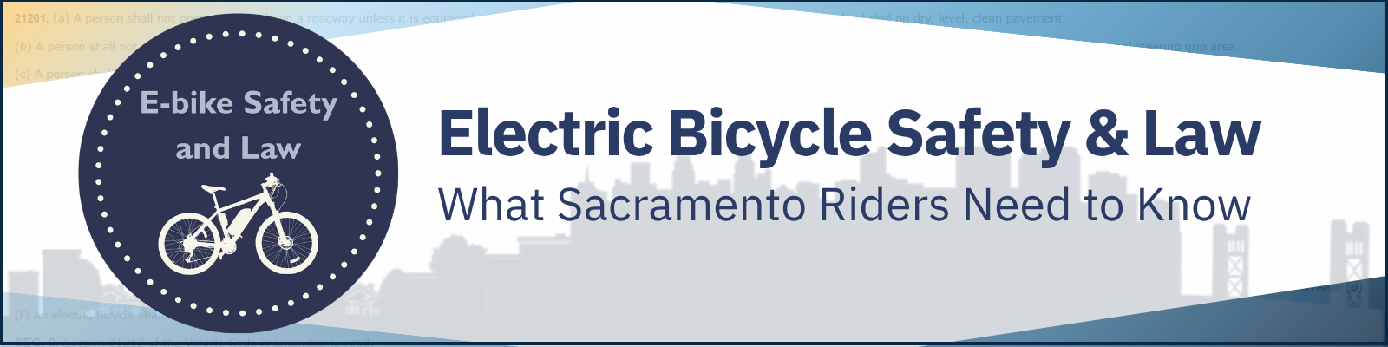
Agenda:
Sacramento Vision Zero Action Plan Update
Fruitridge Road Safety and Mobility Plan
E-bike Safety and Law Education Campaign
Notes:
Today I will provide a brief overview of:
The Sacramento Vision Zero Action Plan Update
Fruitridge Road Safety and Mobility Plan
And the E-bike Safety and Law Education Campaign

Slide 3
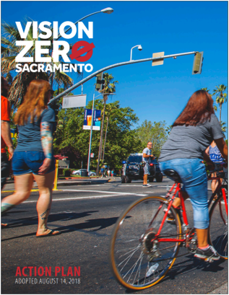
What is Vision Zero?
Vision Zero is the City’s commitment to eliminating transportation deaths and serious injuries through collaborative efforts, safe infrastructure, and community engagement to foster safer streets for everyone.
Notes:
Vision Zero is the City’s commitment to eliminating transportation deaths and serious injuries through collaborative efforts, safe infrastructure, and community engagement to foster safer streets for everyone.
The City adopted the first Vision Zero Action Plan in 2018
Although much has been done since then, there is more to do

Slide 4
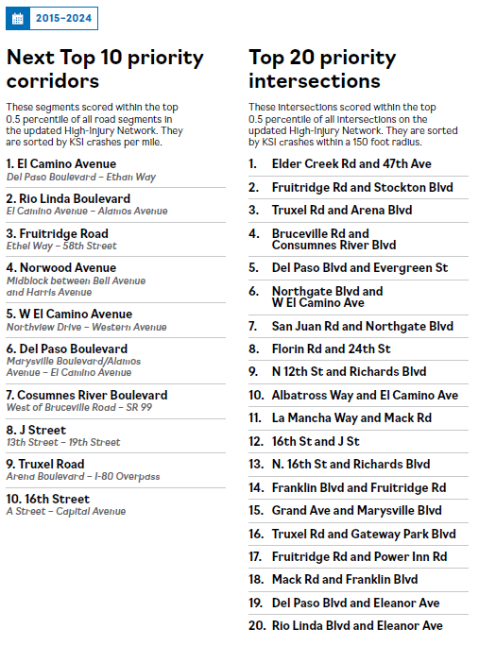
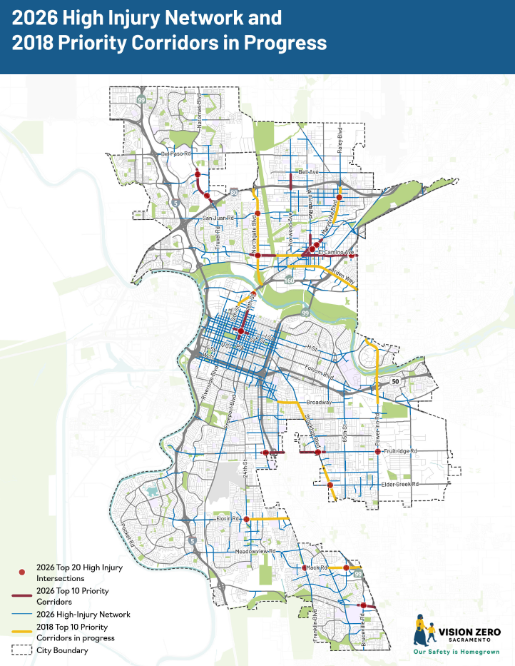
Notes:
The Vision Zero Action Plan update refines the High Injury Network, the network of streets that have the highest number of fatal and severe injury crashes
It maintains the original Top 10 corridors so work can continue and adds the Next 10 Priority Corridors
As well as 20 Priority Intersections and a set of prioritized actions the City can take to get there

Slide 5
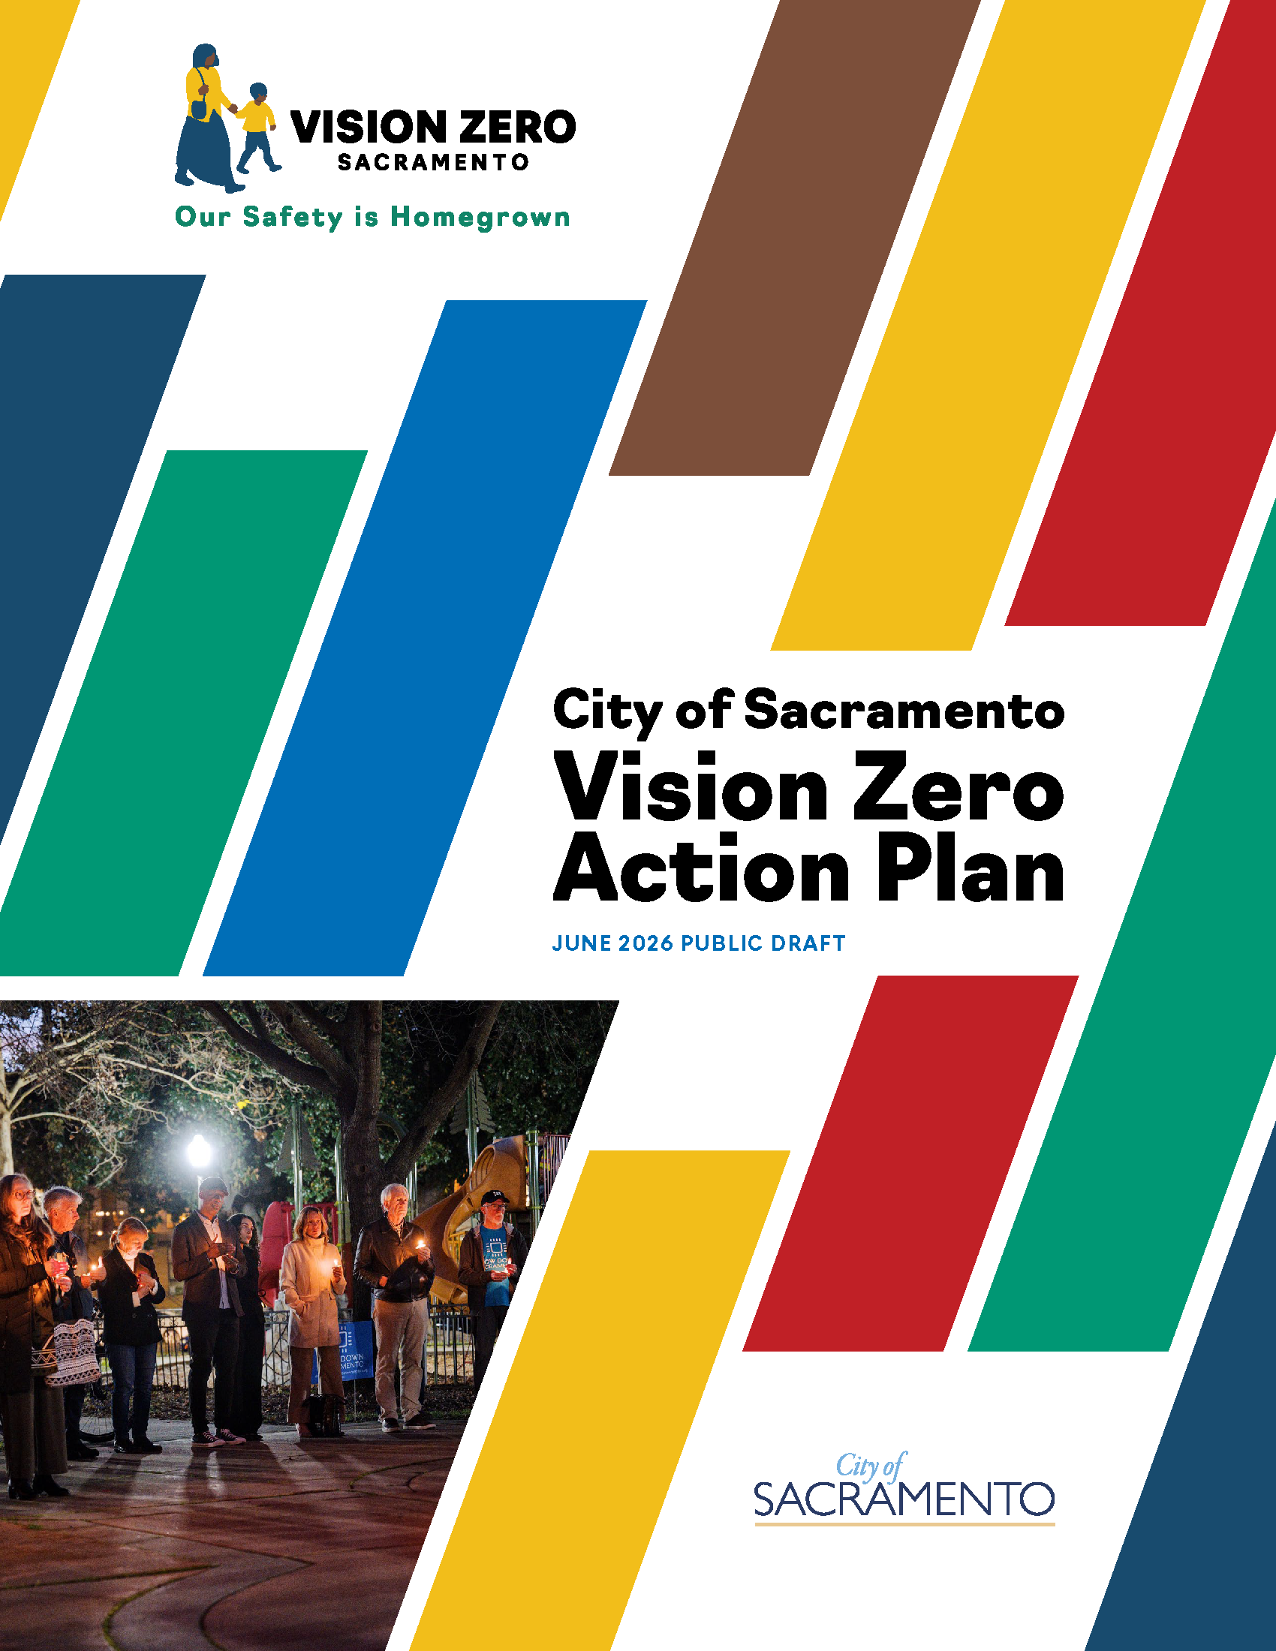

The Draft Vision Zero Action Plan is available for review!
Review the Draft Plan online through August 17th
Attend a Workshop: July 30, 2026, 5:30pm
  La Familia Maple Neighborhood Center
Sign up for updates
VisionZeroSac.org
Notes:
The Public Draft Plan is now available for review through August 17th
You can review the plan online and leave comments right in the document
Attend our final workshop on July 30th at La Familia’s Maple Neighborhood Center
And make sure you sign up for updates
All at VisionZeroSac.org

Slide 6
The Fruitridge Road Safety and Mobility Plan is a transportation planning effort to improve a key east-west corridor by enhancing safety, mobility, and access for all roadway users
Notes:
The Fruitridge Road Safety and Mobility Plan is a transportation planning effort to improve a key east-west corridor by enhancing safety, mobility, and access for all roadway users

Slide 7
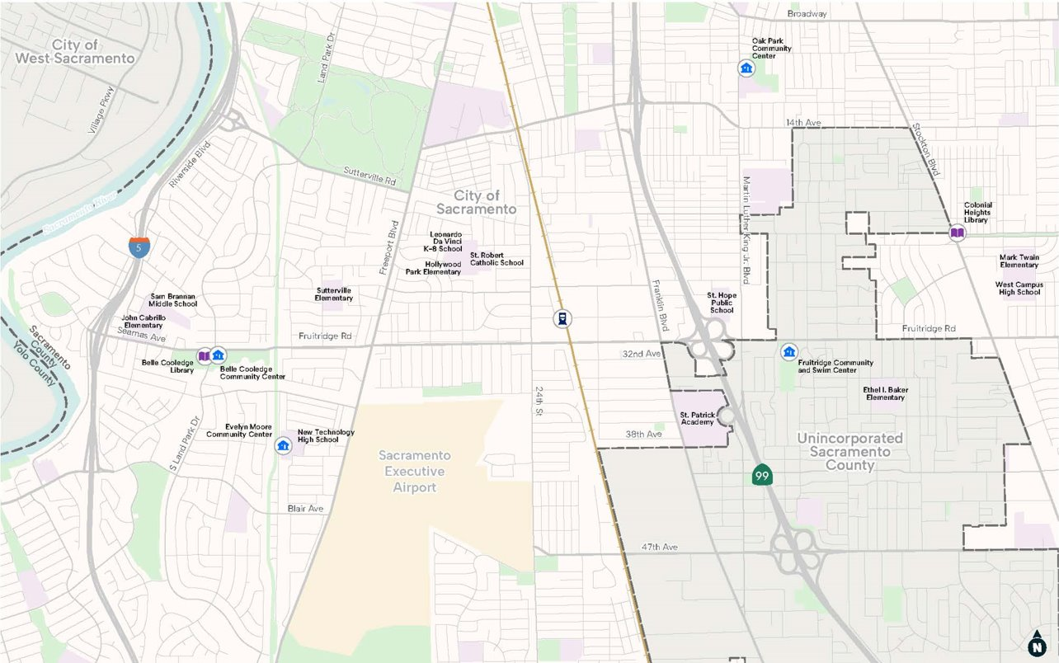
Plan Goals
Create a common vision
Improve active transportation, transit access, and safety
Create a complete network
Provide economic activation
Project Area
Notes:
The plan is evaluating the 4-mile stretch of Fruitridge Road from Riverside Blvd to Stockton Blvd
The project goals and objectives are to:
Create a common vision that is reflective of the communities’ goals.​
Connect multiple transportation efforts and improve opportunities for active transportation options, transit access, and safety.​
Create a complete network to daily needs and destinations along Fruitridge Road.​
Help challenged business by providing more economic activation through increased active transportation and transit.

Slide 8
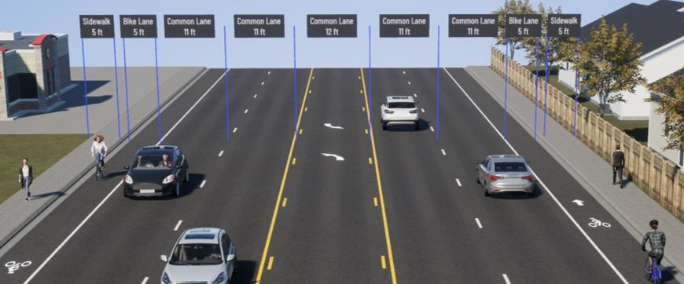
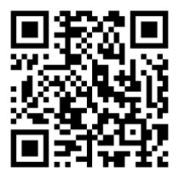
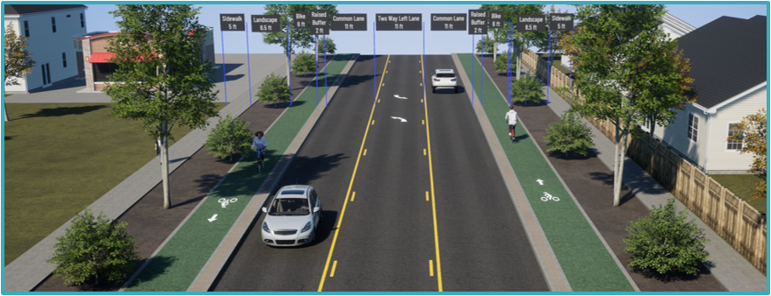
Let us know what you think!
Our Phase 2 online survey is available until TOMORROW, July 23.
Existing Conditions
Find out more at the project webpage: CityofSacramento.gov/FruitridgePlan
Draft Design Concept
8
Notes:
We are currently gathering feedback for Phase 2 of this project, which includes a set draft design concepts for roadway improvements including traffic calming and bike facilities.
You can review these concepts and provide feedback on our online survey, which is available until tomorrow, July 23.
You can see all the project documents so far, as well as sign up for future updates, at the project webpage at CityofSacramento.org/FruitridgePlan

Slide 9

E-bike Safety and Law Campaign
This new campaign is a collaboration between Public Works, SacPD, and YPCE informing the public, about electric bicycle (e‑bike) laws and safe riding practices.
Notes:
Finally, I will share another exciting project, our E-bike Safety and Law Campaign.
(Share story of how campaign emerged from townhall – response to national news and concerns from the public – led to collaboration between Public Works, SacPD, and YPCE)
The goal of the campaign is to inform the public, especially youth and their caretakers, about e-bike laws and safe riding practices.

Slide 10
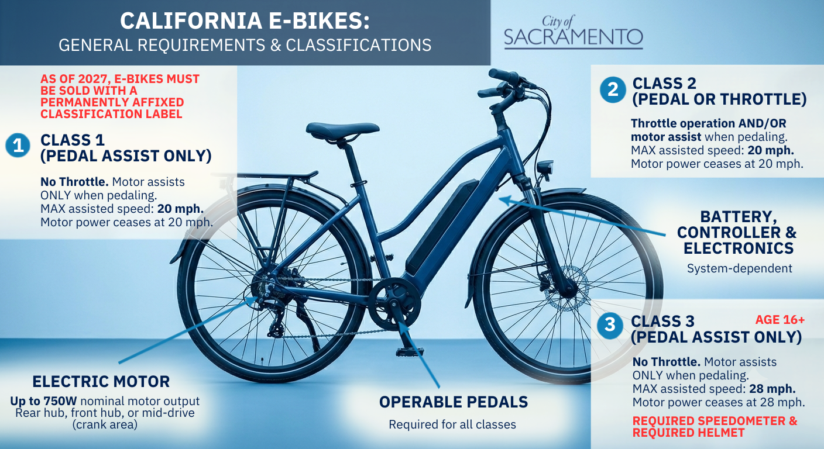
Key Messages:
Distinctions between e‑bike classes
How e‑bikes differ from faster e‑mopeds and e‑motos
Where you can ride and best practices for safety
Practicing good etiquette on shared-use paths
Requirements for youth and parent / guardian responsibility
Notes:
E-bikes are a rapidly evolving technology, and policy is keeping up. However, the public and riders are not always aware of all the requirements. Our campaign covers:
Distinctions between e‑bike classes
How e‑bikes differ from faster e‑mopeds and e‑motos
Where you can ride and best practices for safety
Practicing good etiquette on shared-use paths
Requirements for youth and parent / guardian responsibility

Slide 11
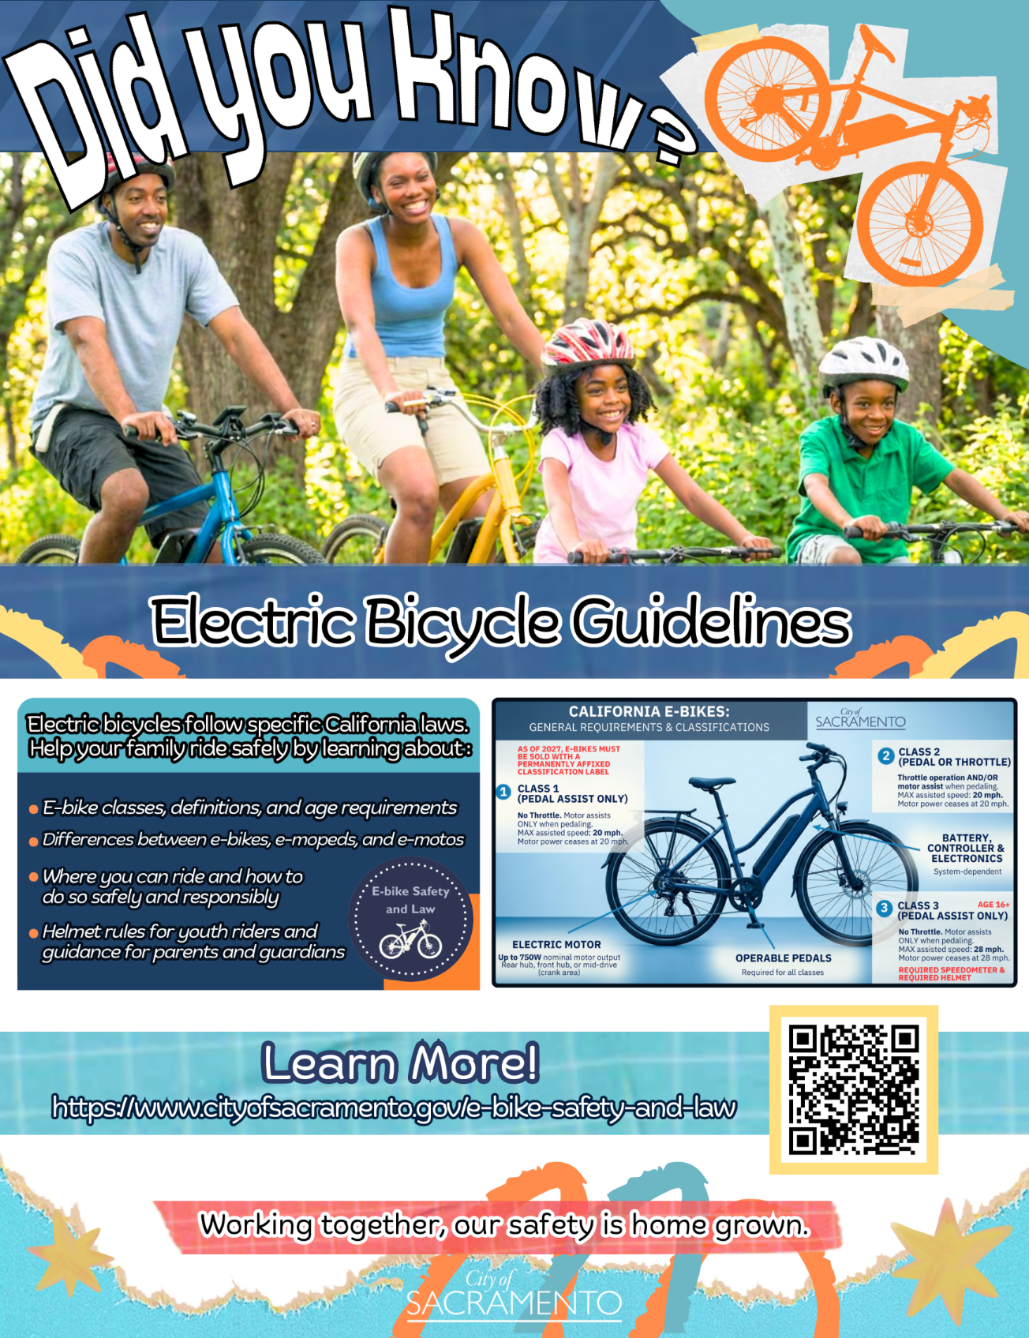
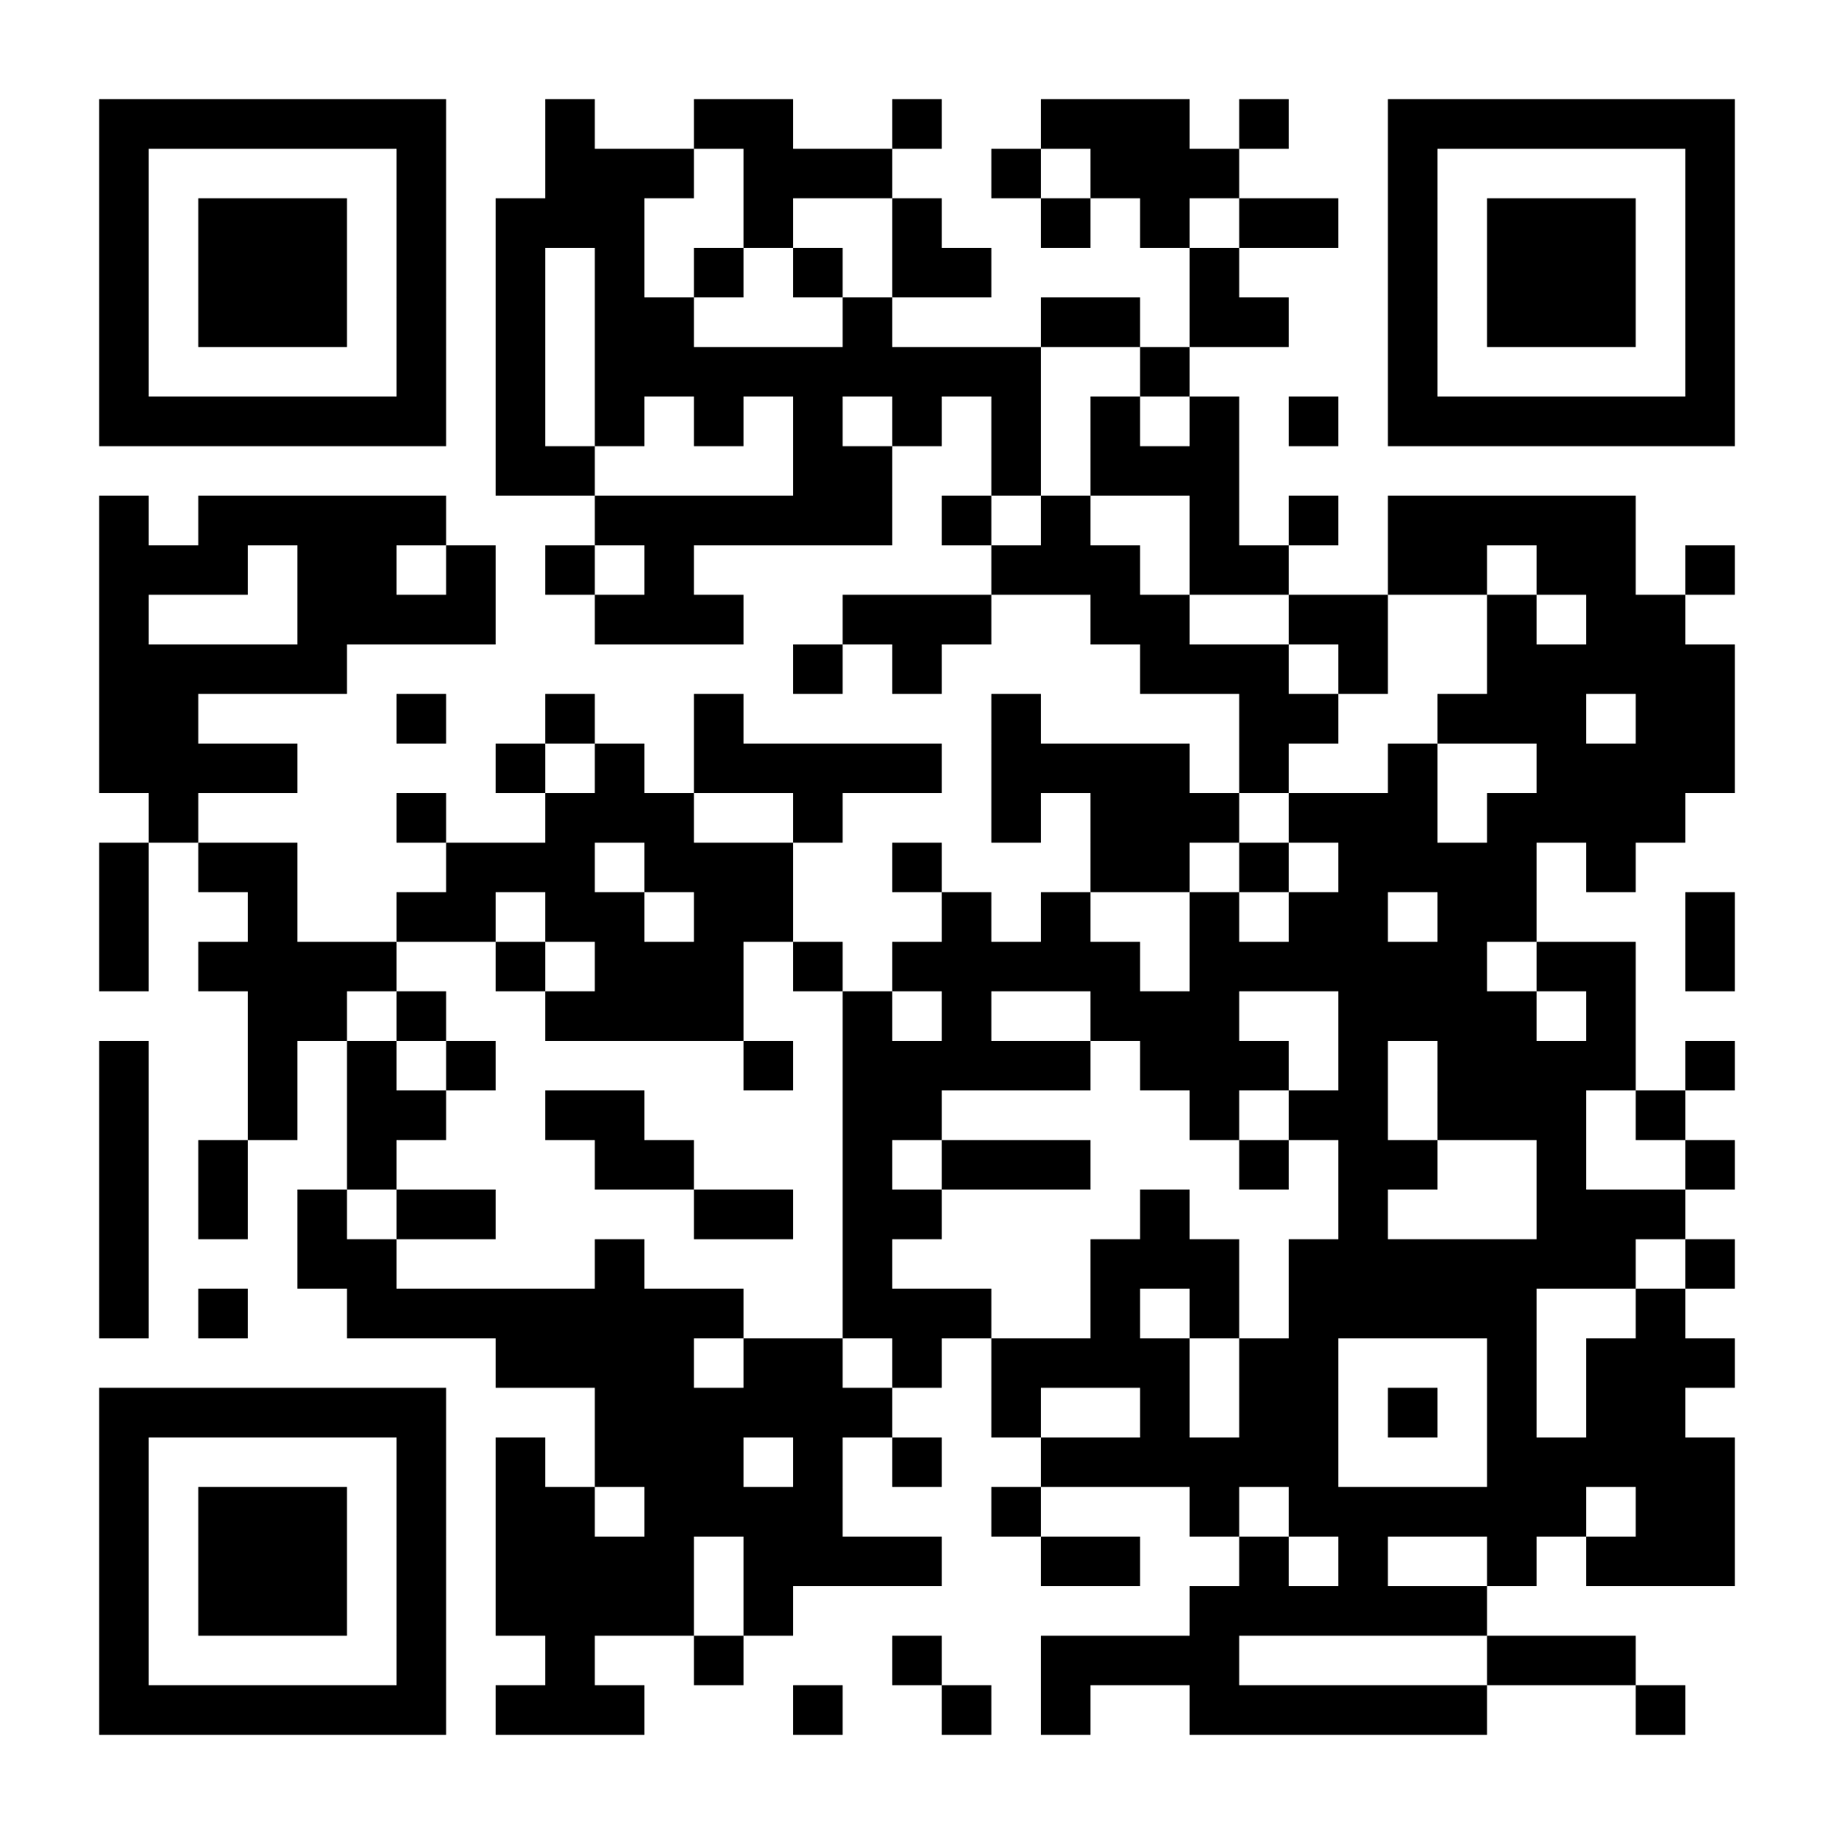
This Summer
🌐 Browse our new webpage
📣 Like and share our social media posts
🎥 Watch SacPD’s new safety video
🪧 Look for Love Your Parks trail signage
🎒 Find us at back‑to‑school events
✨ And more…
https://www.cityofsacramento.gov/e-bike-safety-and-law
Notes:
Public Works, YPCE, and SacPD have reviewed local and State law and prepared new materials to help the community to understand the requirements.
We've created a new webpage with summaries and resources, SacPD and other local and regional agencies have filmed a PSA video that will be released soon.
We are launching a social media campaign, planning signage for local trails through the Love Your Parks project, sharing resources with Council offices and schools, and going out into the community to share this information.
(Add summary/ wrap up sentence)

Slide 12
Thank you!
Notes:
Thank you!
Visit us at the Mobility and Sustainability table to talk with staff about these important projects

