Slide 1


Quick Build Program and the Franklin Boulevard Complete Streets Phase 3 Project
Philip Vulliet, Supervising Engineer
Quick-Build Lead, Transportation Division, Public Works
Kelli Lacy, Assistant Civil Engineer
Engineering Services, Public Works
Date 07/22/2026
Notes:
Good evening everyone. My name is Philip Vulliet, and I am a Supervising Engineer in the Transportation Division for Sacramento Public Works. I’m excited to be here presenting on the Traffic Safety Initiative in the City of Sacramento Public Works Department. There should be plenty of time at the end of my presentation for questions and discussion and other sharing on the topic of safety.
A little background about myself - I have worked for the City of Sacramento for over 11 years, starting as an Associate Engineer, and have progressively promoted to my current role. For the past 20 years I have managed Capitol Improvement Projects in Sacramento and throughout the region. Safety is always a primary goal of the City’s CIP projects but in my new role with the Transportation Division I will be charged with building the City’s quick build capabilities outside of traditional CIP work.
At the City, the Transportation Division is responsible for maintenance of traffic control devices, taking care of all street signs and pavement markings, as well as traffic signals and street lighting; our team also manages engineering roles such as traffic studies, private development requirements, plan review for both private and capital improvement projects, traffic signal operations, design, and advancing detection technologies, and customer service related to community traffic safety requests.

Slide 2
Agenda
History of the Quick Build Program
  2018 Vision Zero Action Plan
  Transportation Safety Initiative
How We’re Building the Quick Build Program
Franklin Blvd Complete Streets Phase 3 Update
Q&A
Notes:
Before we jump into the Quick Build program we will
Touch on the recent history regarding traffic safety in the City
The 2018 Vision Zero Plan
Our crash history
Some recent CIP project efforts
The 2025 TSI by City Council
Our efforts to ramp up the City’s quick build capabilities

Slide 3
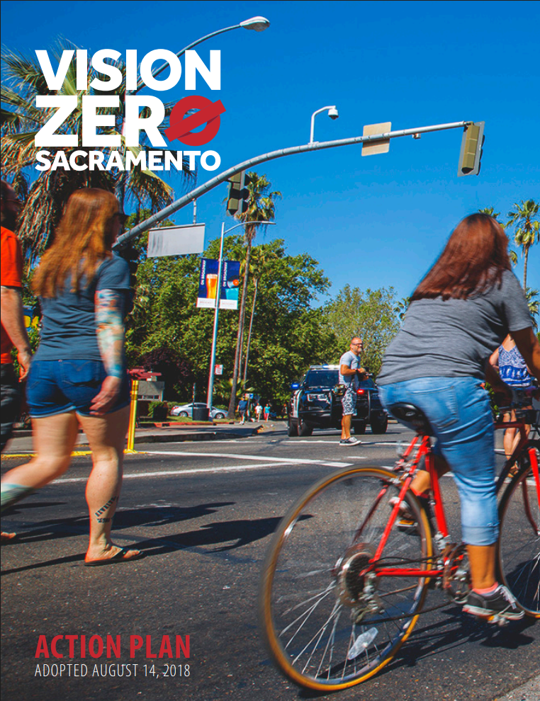
Vision Zero
2018 Council Adopted
Action Plan
Notes:
In August of 2018, Sacramento City Council adopted it’s first Vision Zero action plan to “work collaboratively in a data-driven effort to eliminate traffic fatalities and serious injuries”.
The City developed this plan using crash data from the years 2009-2015, analyzing crash trends, developing countermeasure recommendations, and establishing policies that would guide all our work for the next 10 years.
Since the 2018 adoption, every investment in street and roadway improvements has been with a Vision Zero lens.

Slide 4

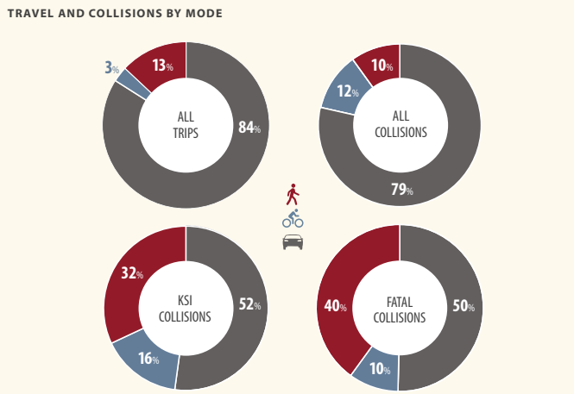
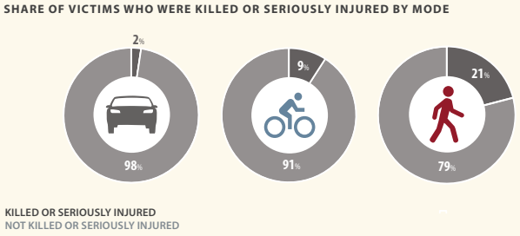
#crashhistory
Disproportionately Ped & Bike
Notes:
At the time of the study, the data highlighted the need to focus our attention and investments to make walking and biking safer. These charts, from the action plan, clearly show the disproportionate toll that traffic violence causes on the most vulnerable users of our streets.
While biking makes up only 3% of trips, 12% of all collisions involve a bicyclist, and 16% of collisions where a fatality or severe injury occurred.
And the stats for walking are even worse. With only 10% of all collisions involving a pedestrian, they attribute to 40% of all fatal crashes.
The 2018 Vision Zero Action Plan also defined the City’s High Injury Network, which identifies the corridors with the highest levels of fatal and serious crashes for all modes. The High Injury Network only makes up 14% of Sacramento’s roadways, but those corridors contain 79% of all crashes and 77% of all KSI crashes.
The data analysis also revealed that 78% of collisions occur at intersections.

Slide 5
2020-2024 Crash Data
12,951
All Mode Crashes
826
1,081
224/75
Serious Injury
Pedestrian-Involved Crashes
Severe Injury/Killed
Still Not Zero
166
974
113/18
Fatal Crashes
Bicycle Involved Crashes
Severe Injury/Killed
Notes:
Even with several years of focus and $10’s, if not $100’s, of millions of dollars in investment, crashes keep happening and people keep dying on our streets. As of 2022, looking at 5 previous years of data, Sacramento still has one of the highest numbers of traffic fatalities, per 100k residents, across California.
These were the statistics that the City was grappling with as we entered 2025 and Council decided to take action…….

Slide 6
Transportation Safety Initiative
Sacramento City Council Adopted March 2025, Funded FY26
Notes:
While the number of crashes and fatalities were trending down from 2023 to 2024, in 2024 we still lost 23 people including 8 pedestrians and 5 cyclists.
So, Sacramento is taking a new approach.
We developed and proposed the Transportation Safety Initiative to City Council in March of 2025, with dedicated funding established in the 2026 fiscal year.

Slide 7
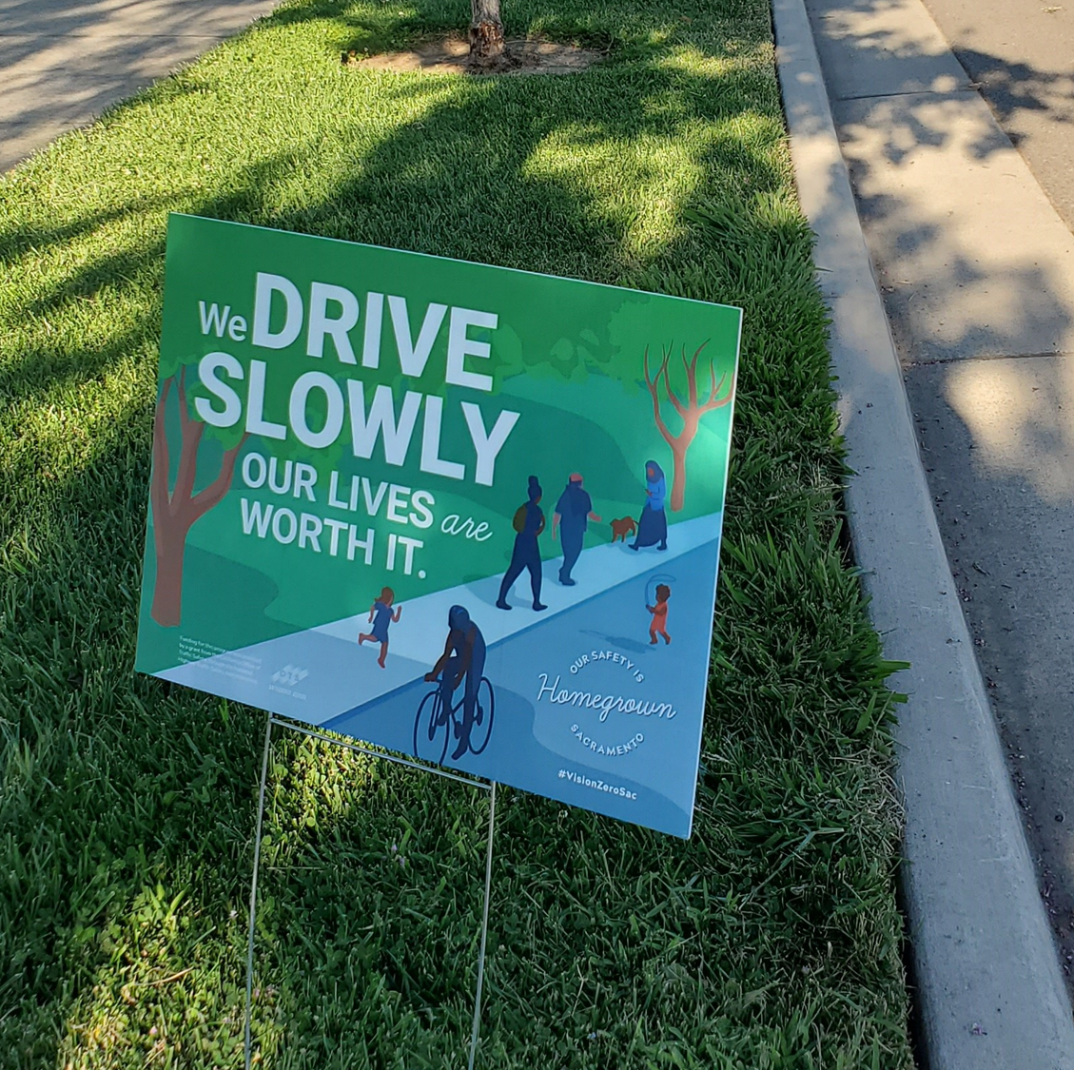
Our Responsibility to Act
Identify, Fund & Implement Quick-Build Solutions
Be more responsive and innovative in implementing traffic safety solutions
Engage with Community
Be Transparent
Expedite Projects in High-Risk Areas
Notes:
The Public Works team heard from community and council through the discussion around a state of emergency that there are several key goals:
Identify, fund, and implement quick-build solutions
be more responsive and innovative to reducing traffic fatalities
Engage with the Community in the development of the project locations and the solutions
Be Transparent – communicate the timeline, design decisions, and progress
Expedite Projects in High-Risk Areas
The City’s current safety response efforts within Public Works reside in three Divisions: Mobility and Sustainability (MaS), Transportation, and Engineering Services. MaS manages the planning, programing, and policy support. Transportation and Engineering Services implement infrastructure components within staffing and funding capacities.
With this initiative, the Transportation Safety Team has been established within the Transportation Division to lead and implement swift safety improvements across Sacramento’s High Injury Network (HIN) that are integrated with other Public Works transportation safety planning, programs and initiatives. The Transportation Safety Team’s mission is to reduce traffic fatalities and serious injuries through quick proactive interventions, aligned with the city’s Vision Zero goals.
In addition, resources have been redirected to deliver interim, quick-build improvements on critical corridors such as the VZ Top 10 HIN corridors, where feasible. As approved, the FY25/26 budget includes the funding framework to implement these new initiatives.
The Transportation Safety Team represents Sacramento’s commitment to creating a city where every resident feels safe on our streets.

Slide 8
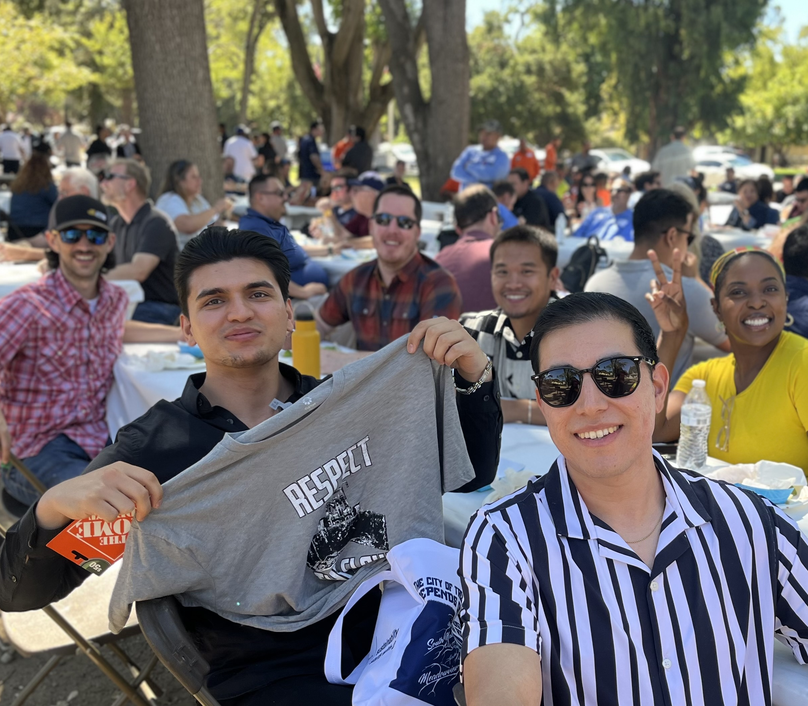
Transportation Safety Team (TST)
Positions – 6 FTE
  1 Supervising Engineer (Me)
  1 Senior Engineer*
  2 Assistant Engineers*
  1 Traffic Investigator
  1 Administrative Analyst*
  *ongoing hiring efforts
Notes:
The key to delivering on this vision to be more nimble, responsive, and innovative starts with staff resources. Public Works is already delivering quick-build, low-cost improvements through the Traffic Investigations team and maintenance crews within the Transportation Division - But the scale of the work is limited by workload capacity and often pulls maintenance crews away from their primary responsibilities to repair existing infrastructure.
Thus, this Transportation Safety Initiative requires a dedicated Transportation Safety Team, made up of:
A supervising engineer that will oversee this team and the Traffic Investigators, leading the greater vision and cross departmental collaboration with the Police department and Council offices, ensuring safety and consistency, but supporting innovation
A senior engineer that will lead the community engagement, oversee the younger engineers, and guide the design and project delivery progress
Two assistant engineers that will be integral in providing the design capacity and promised responsiveness to all communities throughout Sacramento
The original plan was to utilize an experienced Traffic Investigator, skilled in field measurement, on-site evaluation, document research, and customer service. The Gator Team (as we call them) has had complete turn over in the last year. Thus, we’ve adjusted the plan to utilize the entire team as an extension of the TST, giving them all opportunities to serve and improve the districts they represent.
Lastly, this team will need administrative support to manage the constant flow of construction efforts and reporting related to the quick-build treatments.

Slide 9
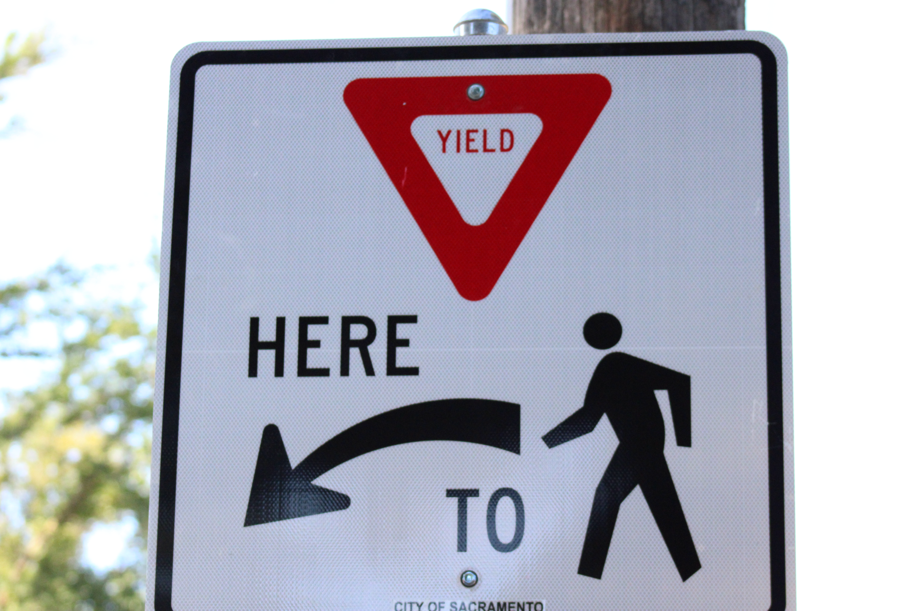
Defining Quick Builds
Rapid Implementation Limitations
No land acquisitions
Electrical work limited
Excavation only by City crews
Council action - Assigned projects in Tiers
Notes:
With new dedicated staffing and resources, the City will implement quick, cost-effective solutions that can be implemented within months to address high-risk areas.
But what is a “Quick Build”? – It’s helpful to discuss the limitations related to the desired rapid deployment of these safety measures. In order to meet rapid timelines:
No land (Right of Way) – this is typically a lengthy process on projects
Very limited electrical work – Electrical materials can take up to 9 months to order/receive
No digging by contractors – Utility coordination for contractor led projects is extensive. In cases where new pedestrian ramps are needed, we will use City crews.
The 2025 council action also identified a Tier system for defining QBs.

Slide 10
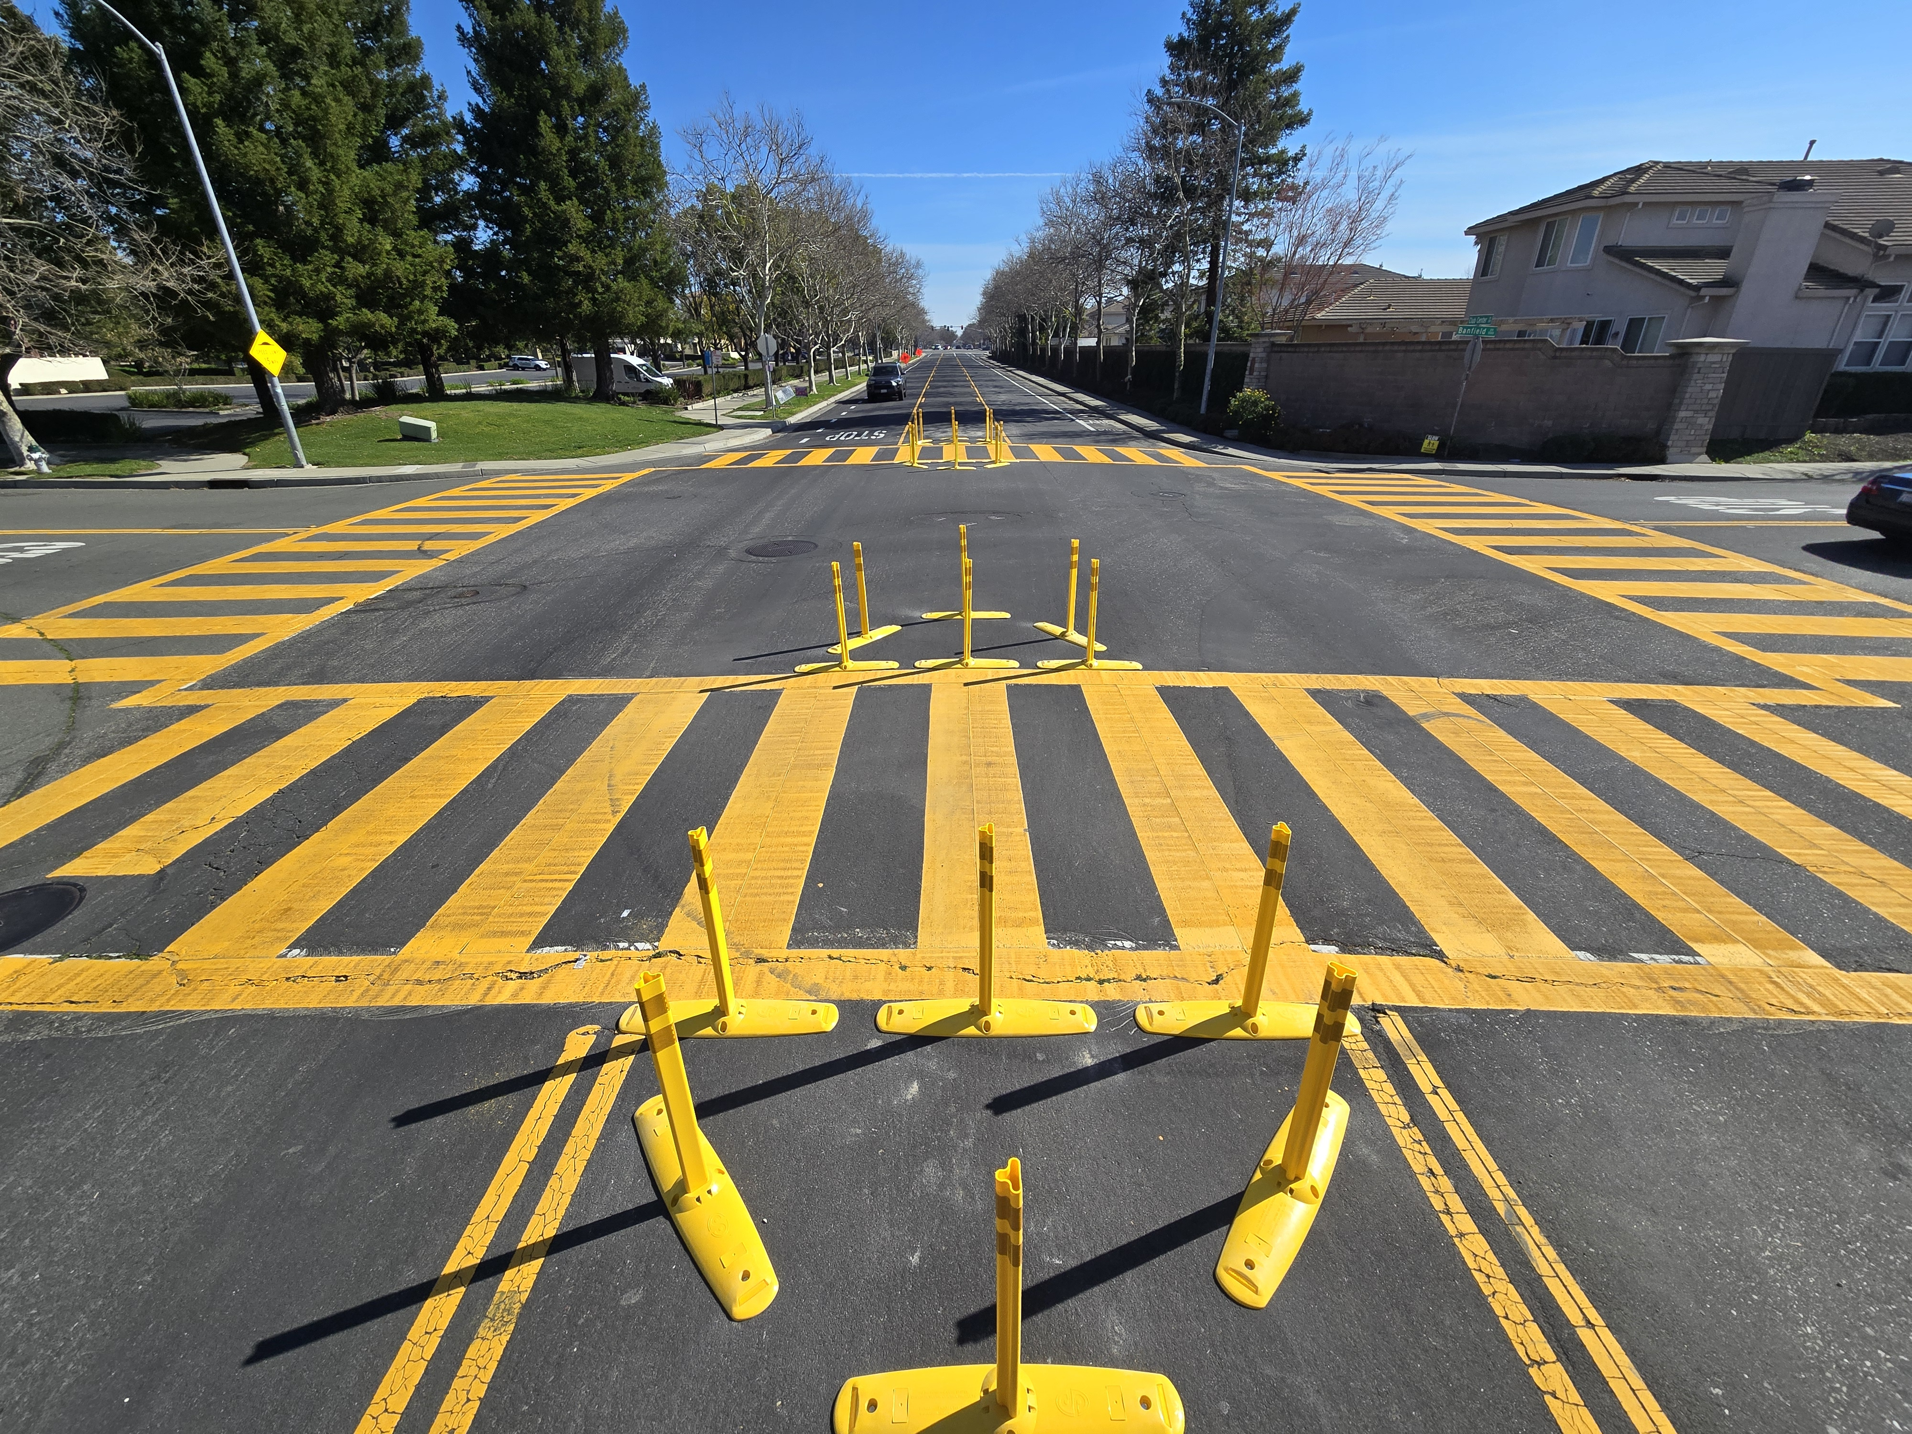
Tier 1 Quick Build Projects
Surface Treatments
Tuff Curb & Striping
Improved Signage
High-Vis Markings
Minor Signal Work (i.e. Timing)
Limitations
Alterations in traffic circulation
Club Center Drive at Banfield Drive, District 1
Notes:
So lets dive into what was termed as “Tier 1” by the 2025 council action. These are the types of improvements that have been ongoing by our Investigations team and maintenance crews:
Exclusively surface treatments
Tuff Curb with vertical elements – Increased driver awareness, speed reduction, decreased exposure for vulnerable users. Can be used to create separation.
Improved Signage – Better awareness and visibility
Improved Pavement Markings – Yield markings, high visibility cross walks, advance warning markings
These are intended to be our fasted delivery projects. Materials are readily available and design effort is minimal prior to implantation. These don’t include significant changes to traffic circulation which would require lengthier analysis – Adding stop control, lane reductions would require us to assess traffic volumes.

Slide 11

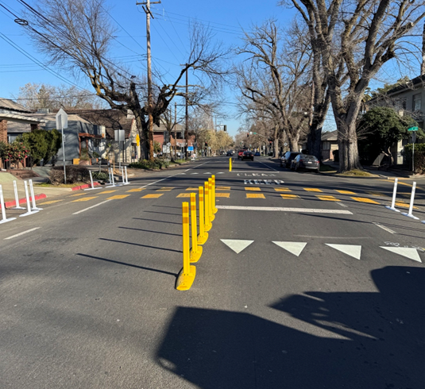
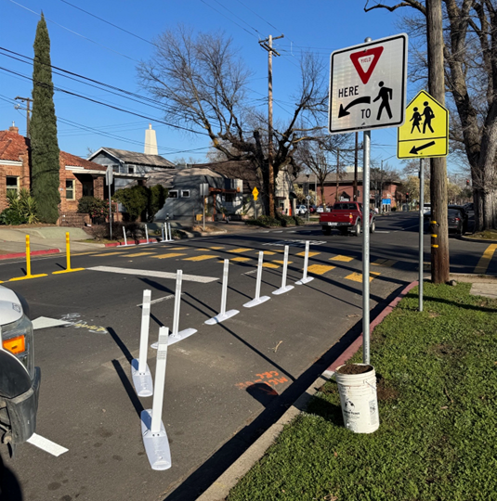
Tier 1 Projects
Community Informed
Resident Concerns
Council Offices
Community Organizations
Neighborhood Associations
Police Dept Hot-Spots
Real-Time Crash Data
Alhambra Blvd at Miwok School, District 4
Notes:
Tier 1 Project locations are most frequently community informed.
• Most frequently these projects are generated by coordination with:
City council members to address district-specific needs, focusing on the most vulnerable populations.
Community organization and neighborhood associations to align projects with local goals and identify locations that may not yet show up in crash data but hinder the community’s feeling of safety
the Police Department to react to current crash trends and recent fatal/serious injury crash locations.
Engagement with users is a critical component

Slide 12
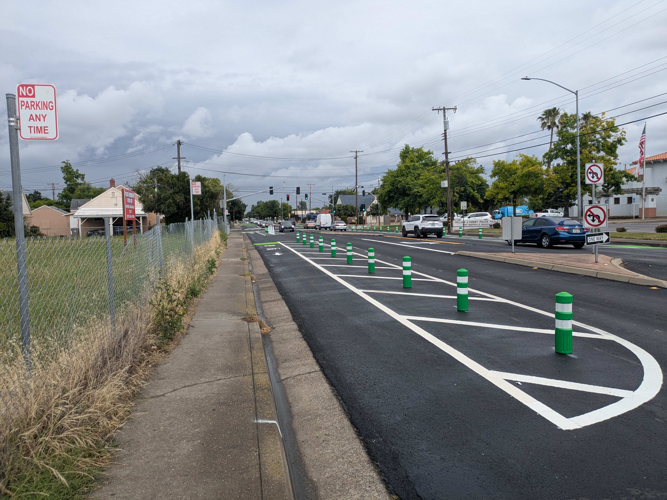
Tier 2 Quick Build Projects
Current Tier 2 Definition
Corridor “pilot projects”
Outside of City crews scope
Require full plans and bidding
Include pavement resurfacing
Marysville, Broadway, Northgate
Marysville Blvd “Quick Build”
Notes:
What was defined as “Tier 2” by the 2025 council action is a little bit of a misnomer to me and we are looking at tweaking those definitions. These are more involved corridor type projects that probably don’t fit the “quick build” moniker quite as well. I prefer to think of them as expedited CIPs:
Frequently corridor pilot projects on the HIN – Quick implementation of some corridor improvements that are planned on HIN roadways
Allows for interim safety improvements while the City procures grant funding for full corridor buildout
Includes lane adjustments and pavement resurfacing
Outside of the level of project typically taken on by City crews
Requires development of full plans and contractor bidding
Significantly longer than Tier 1 – But locally funded to avoid the delays that typically stem from grant funded processes.
Funding authorizations
NEPA
ROW and Utility Certifications
These projects are a very important tool for the City’s transportation initiative – I’m just not sure “Quick Build” is the right terminology here.
We’ve recently completed one of these on Marysville Blvd and are working on a similar effort on Northgate Blvd – Both VZ corridors

Slide 13
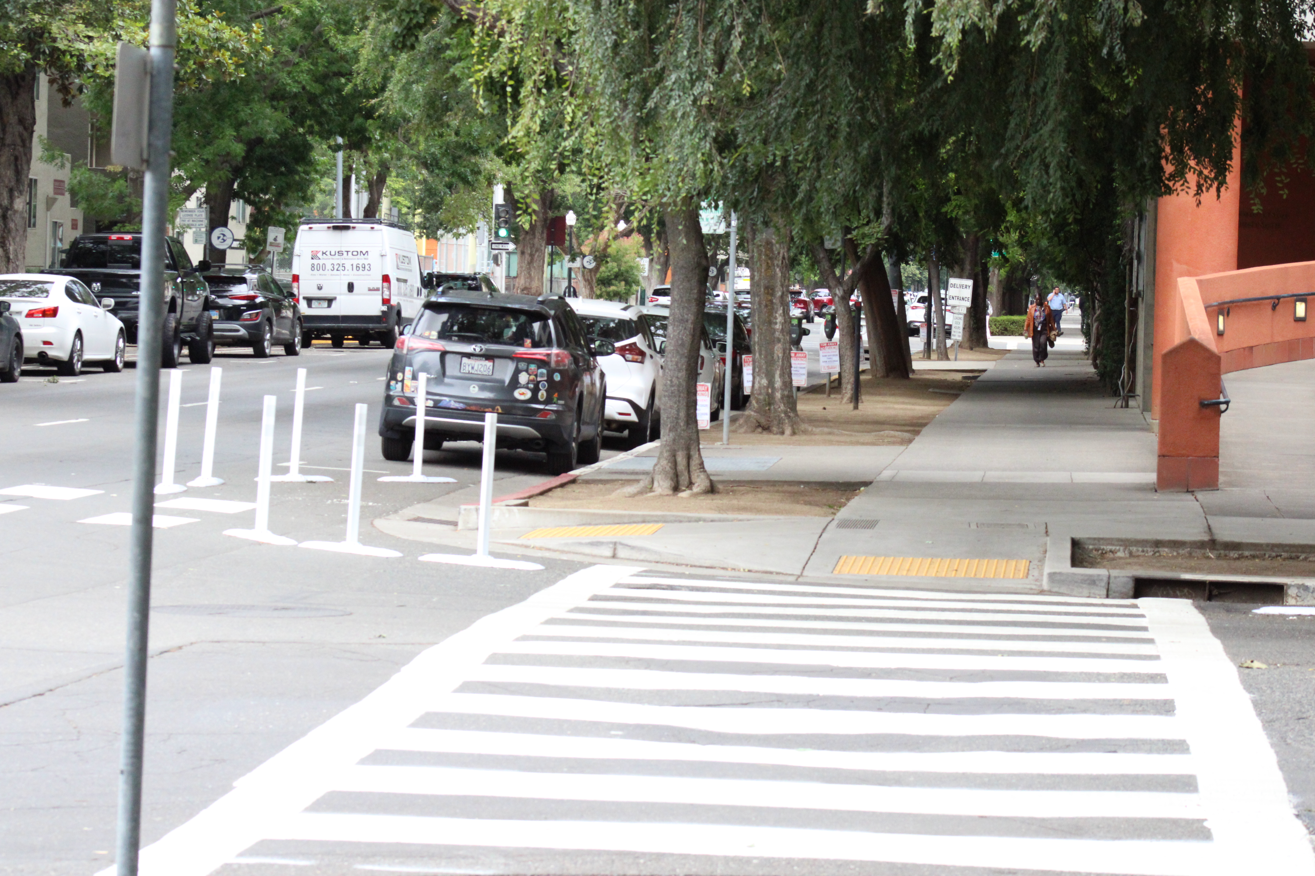
Delivery Goals - Quick Builds
Tier 1 Projects
3-6 months implementation
Tier 2 Projects
8-12 months implementation
What makes these “quick”?
Expedited CIP really
11th & P Streets, District 4
Notes:
So to recap, a quick summary of the current Tier system and the related delivery timing:
Tier 1 Projects – very rapid implementation – 3-6 Months from identification to construction is the goal
Tier 2 Projects – Delivered by Engineering Services, follows more of a CIP delivery method without some of the bigger delay items. The goal is to have these designed and in construction within 12 months.
What I’ve noticed is there is a significant middle ground between these tiers for an intermediate Tier of projects……

Slide 14
Safety Initiative – Funding Commitments
Safety Program - $2.6 million
  Established in FY25/26 Budget Process
  Using existing gas tax and Measure A transportation sales tax
  Annual allocation to support Quick Builds and safety initiatives Citywide
Quick Build CIP - $2 million (Marysville etc.)
  Road Maintenance and Rehabilitation (RMRA Fund 2036) - $1 million
  Major Street Construction (Fund 2007) - $1 million
  Added funding will come online as projects are ready for CON
Notes:
So - how will the team and these projects be funded?
The City’s budgetary issues have been well publicized - so staff analyzed the City’s ongoing annual revenue for dedicated transportation funds (primarily gas tax and Measure A countywide transportation sales tax), looked at five year projections, and identified opportunities to take advantage of cash flow to fund staff positions and contracts on an ongoing basis without affecting the City’s budget deficit.
The new team will rely on the $2.6 million Safety Program which was established with the new FY25/26 Capital Improvement Program, as well as existing programs (including Railway Quiet Zones, Pedestrian Safety, Bicycling Safety, and Vision Zero).
A separate budgetary action was taken to support Engineering Services work on the Tier 2 Projects – It established a new Quick-Build CIP (T15255300) valued at $2 million to allow staff to begin steps for implementation of these projects.

Slide 15
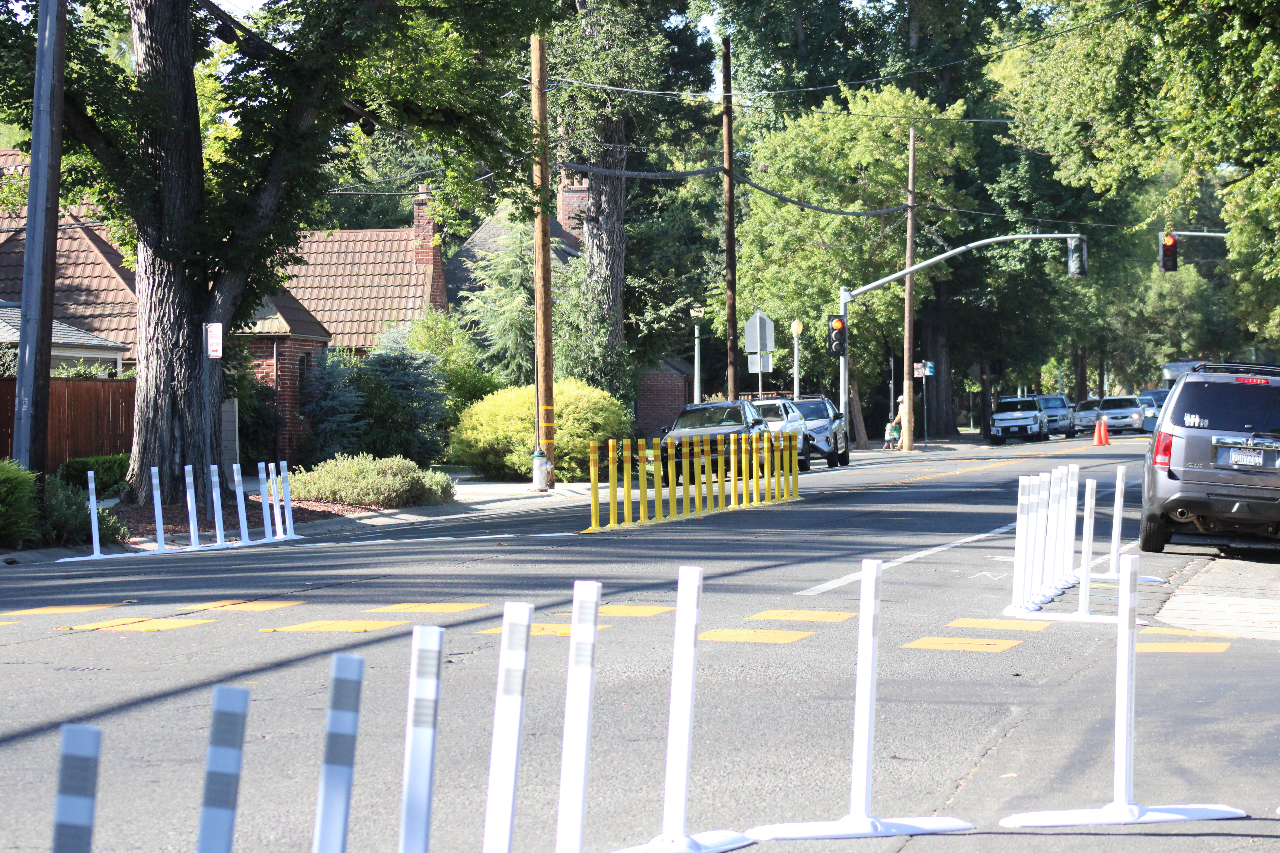
Building a Quick Build Program
What is Required
Contracting Readiness – On Calls
Design Delivery Capacity
Process Updates – New Tech
Outreach, Outreach, Outreach
Follow-up and Reporting
Don’t fear failures!
Robertson Way and Riverside Boulevard, District 7
Notes:
Quick Builds have been moving forward….But how do we supercharge it? We want to be agile and efficient, and we want to deliver these types of improvements IN VOLUME!
How do we accomplish that goal:
Improve our ability to construct these improvements – The Council action in 2025 provided advance approval of on-call contracting
Improve our design capacity – To date most of the quick build improvements have fallen to Investigations to lay out.
Improve our processes – Leverage new technology where available
Outreach is critical – It’s major part of identifying locations
We also need to follow up with community following projects
Finally – don’t fear failure – Making a lot of quick build improvements is going to result in some lessons learned.

Slide 16

Act Fast to Save Lives
Establish a Dedicated Team
Expedite Projects in High-Risk Areas
On-Call Contracting Authority
Leverage Data Tools and Technology

Slide 17
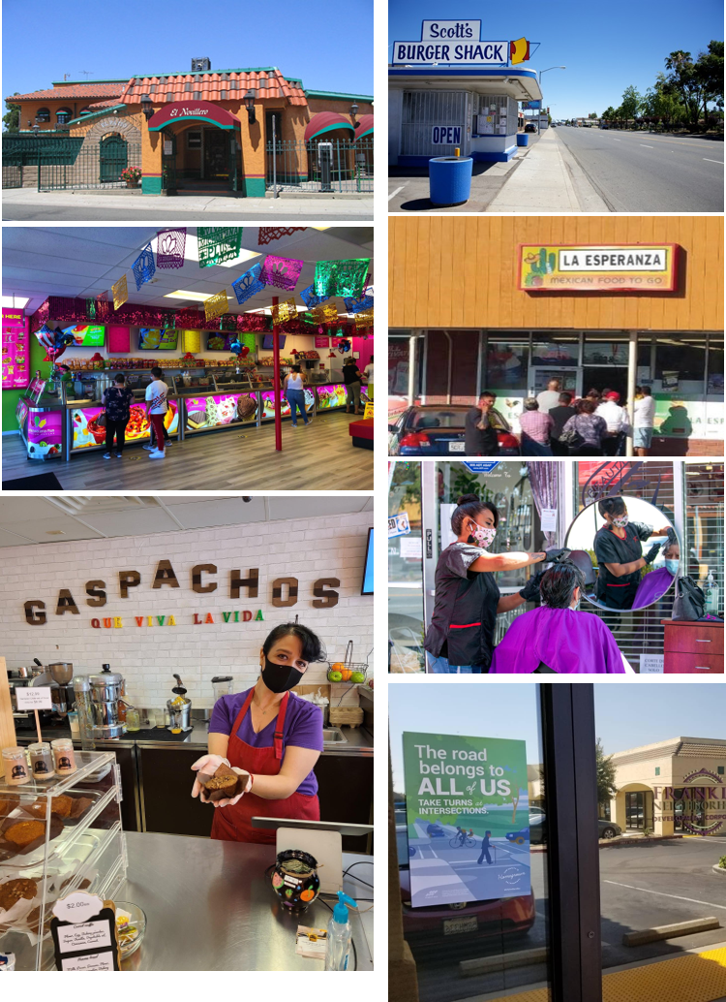
Franklin Boulevard Complete Streets Project
Phase 3
Status Update

Slide 18
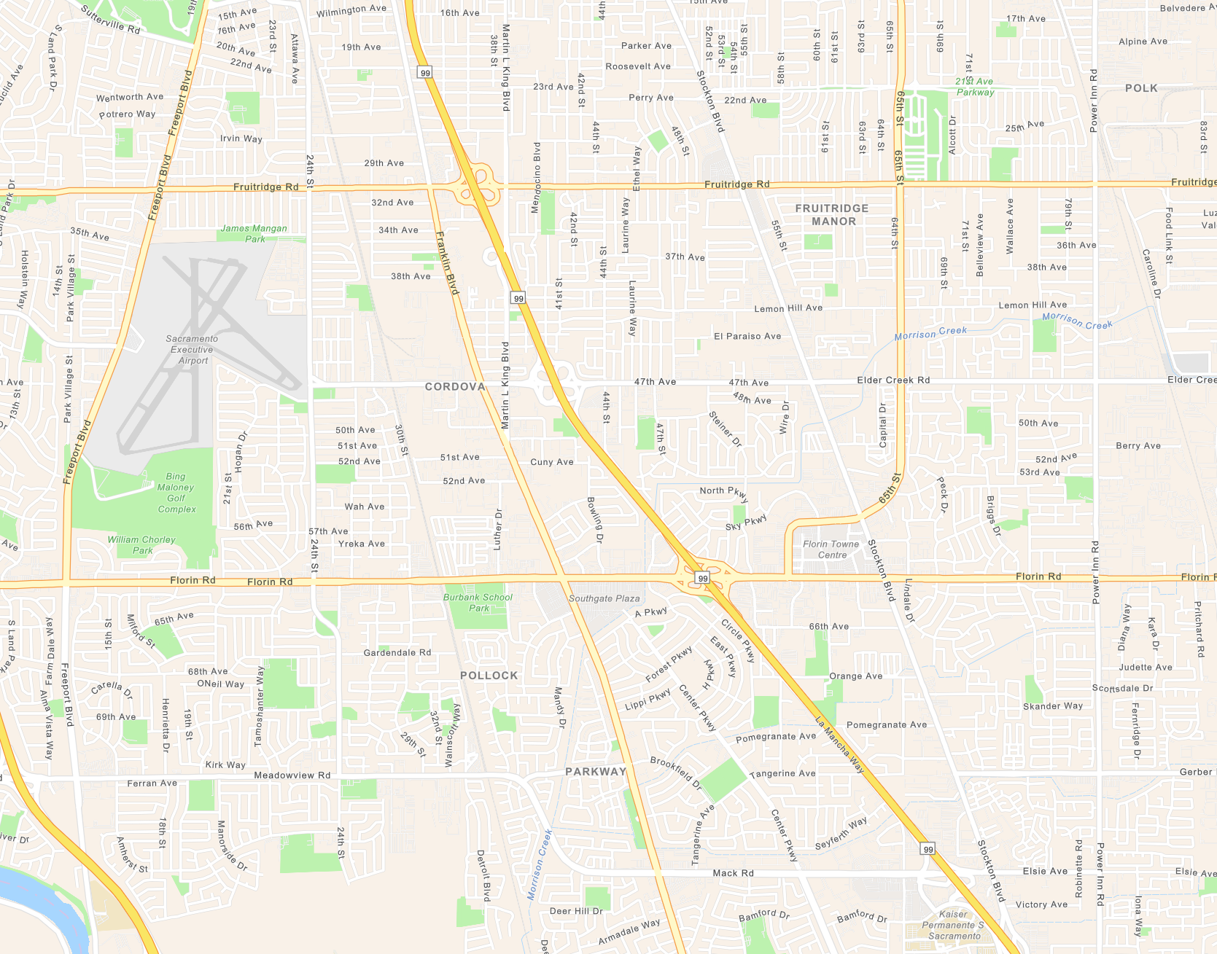
City Franklin Boulevard Complete Streets Projects (T15165500) Sutterville to 38th Ave
Completed City Project: Florin Road Vision Zero (T15215800) 24th Street to Munson Way
SacDOT Franklin Blvd AC Overlay Project
(to be constructed in 2022)
from MLK to Turnbridge
Completed SacDOT: Florin Road Bicycle and Pedestrian Improvement Project (HSIPL-5924(235)) from Franklin Blvd to Power Inn Rd
Completed City Project: Florin Road HSIP 8 (T15185800) and HSIP 9 (T15205400) Projects (from Greenhaven to 24th St Intersections)
SacDOT Franklin Blvd AC Overlay Project
Completed City Project: Franklin Blvd Gap Closure Project
(from A Pkwy to Mack Road)
Completed City Project: Mack Road Overlay Project
(Constructed 2018-19)
(from Morrison Creek to Stockton Blvd)
Completed City Project: 2019 Street Seal on Franklin Blvd (between Mack Road and CRB Blvd)

Slide 19

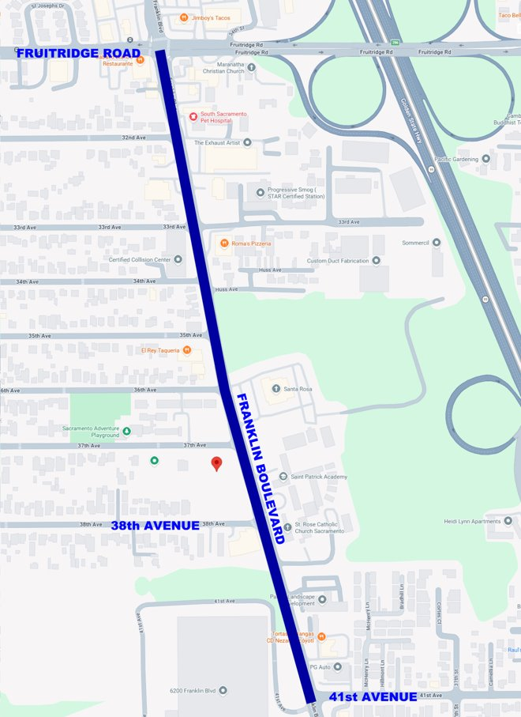
Current Project Location & Scope
Franklin Boulevard between 41st Avenue and Fruitridge Road
Scope Includes:
Lane reduction from 4 to 2 lanes
Class IV bike lanes
Street and pedestrian lighting
Traffic signal modifications
New sidewalk
Landscaping
Pavement rehabilitation

Slide 20
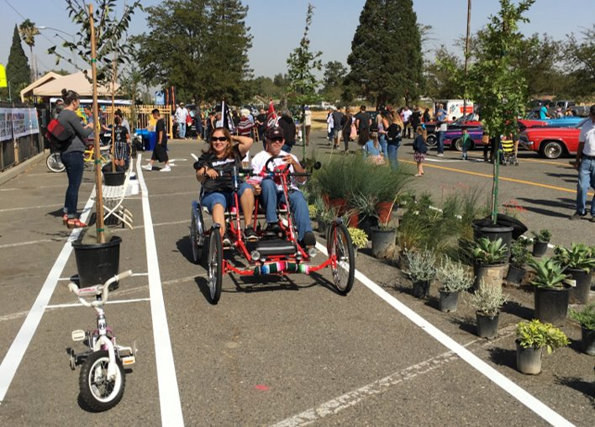
Public Outreach
Extensive outreach efforts during the Phase 1 and Phase 2
Coordination with Franklin Boulevard Business District to re-engage with property and business owners
Additional outreach is planned before and during construction

Slide 21
Project Schedule
Preliminary Engineering | 2022* | to | Feb 2025
Design | Feb 2025 | to | Jan/Feb 2027
Right of Way | Summer 2026 | to | Spring 2027
Construction and Closeout | Fall 2027 | to | Fall 2028

Slide 22
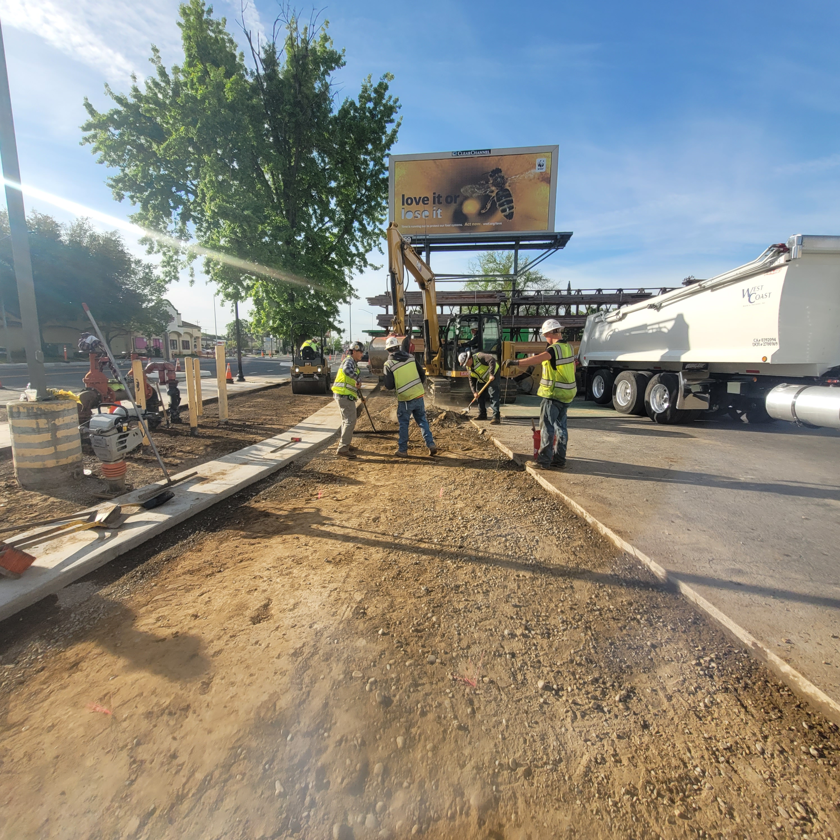
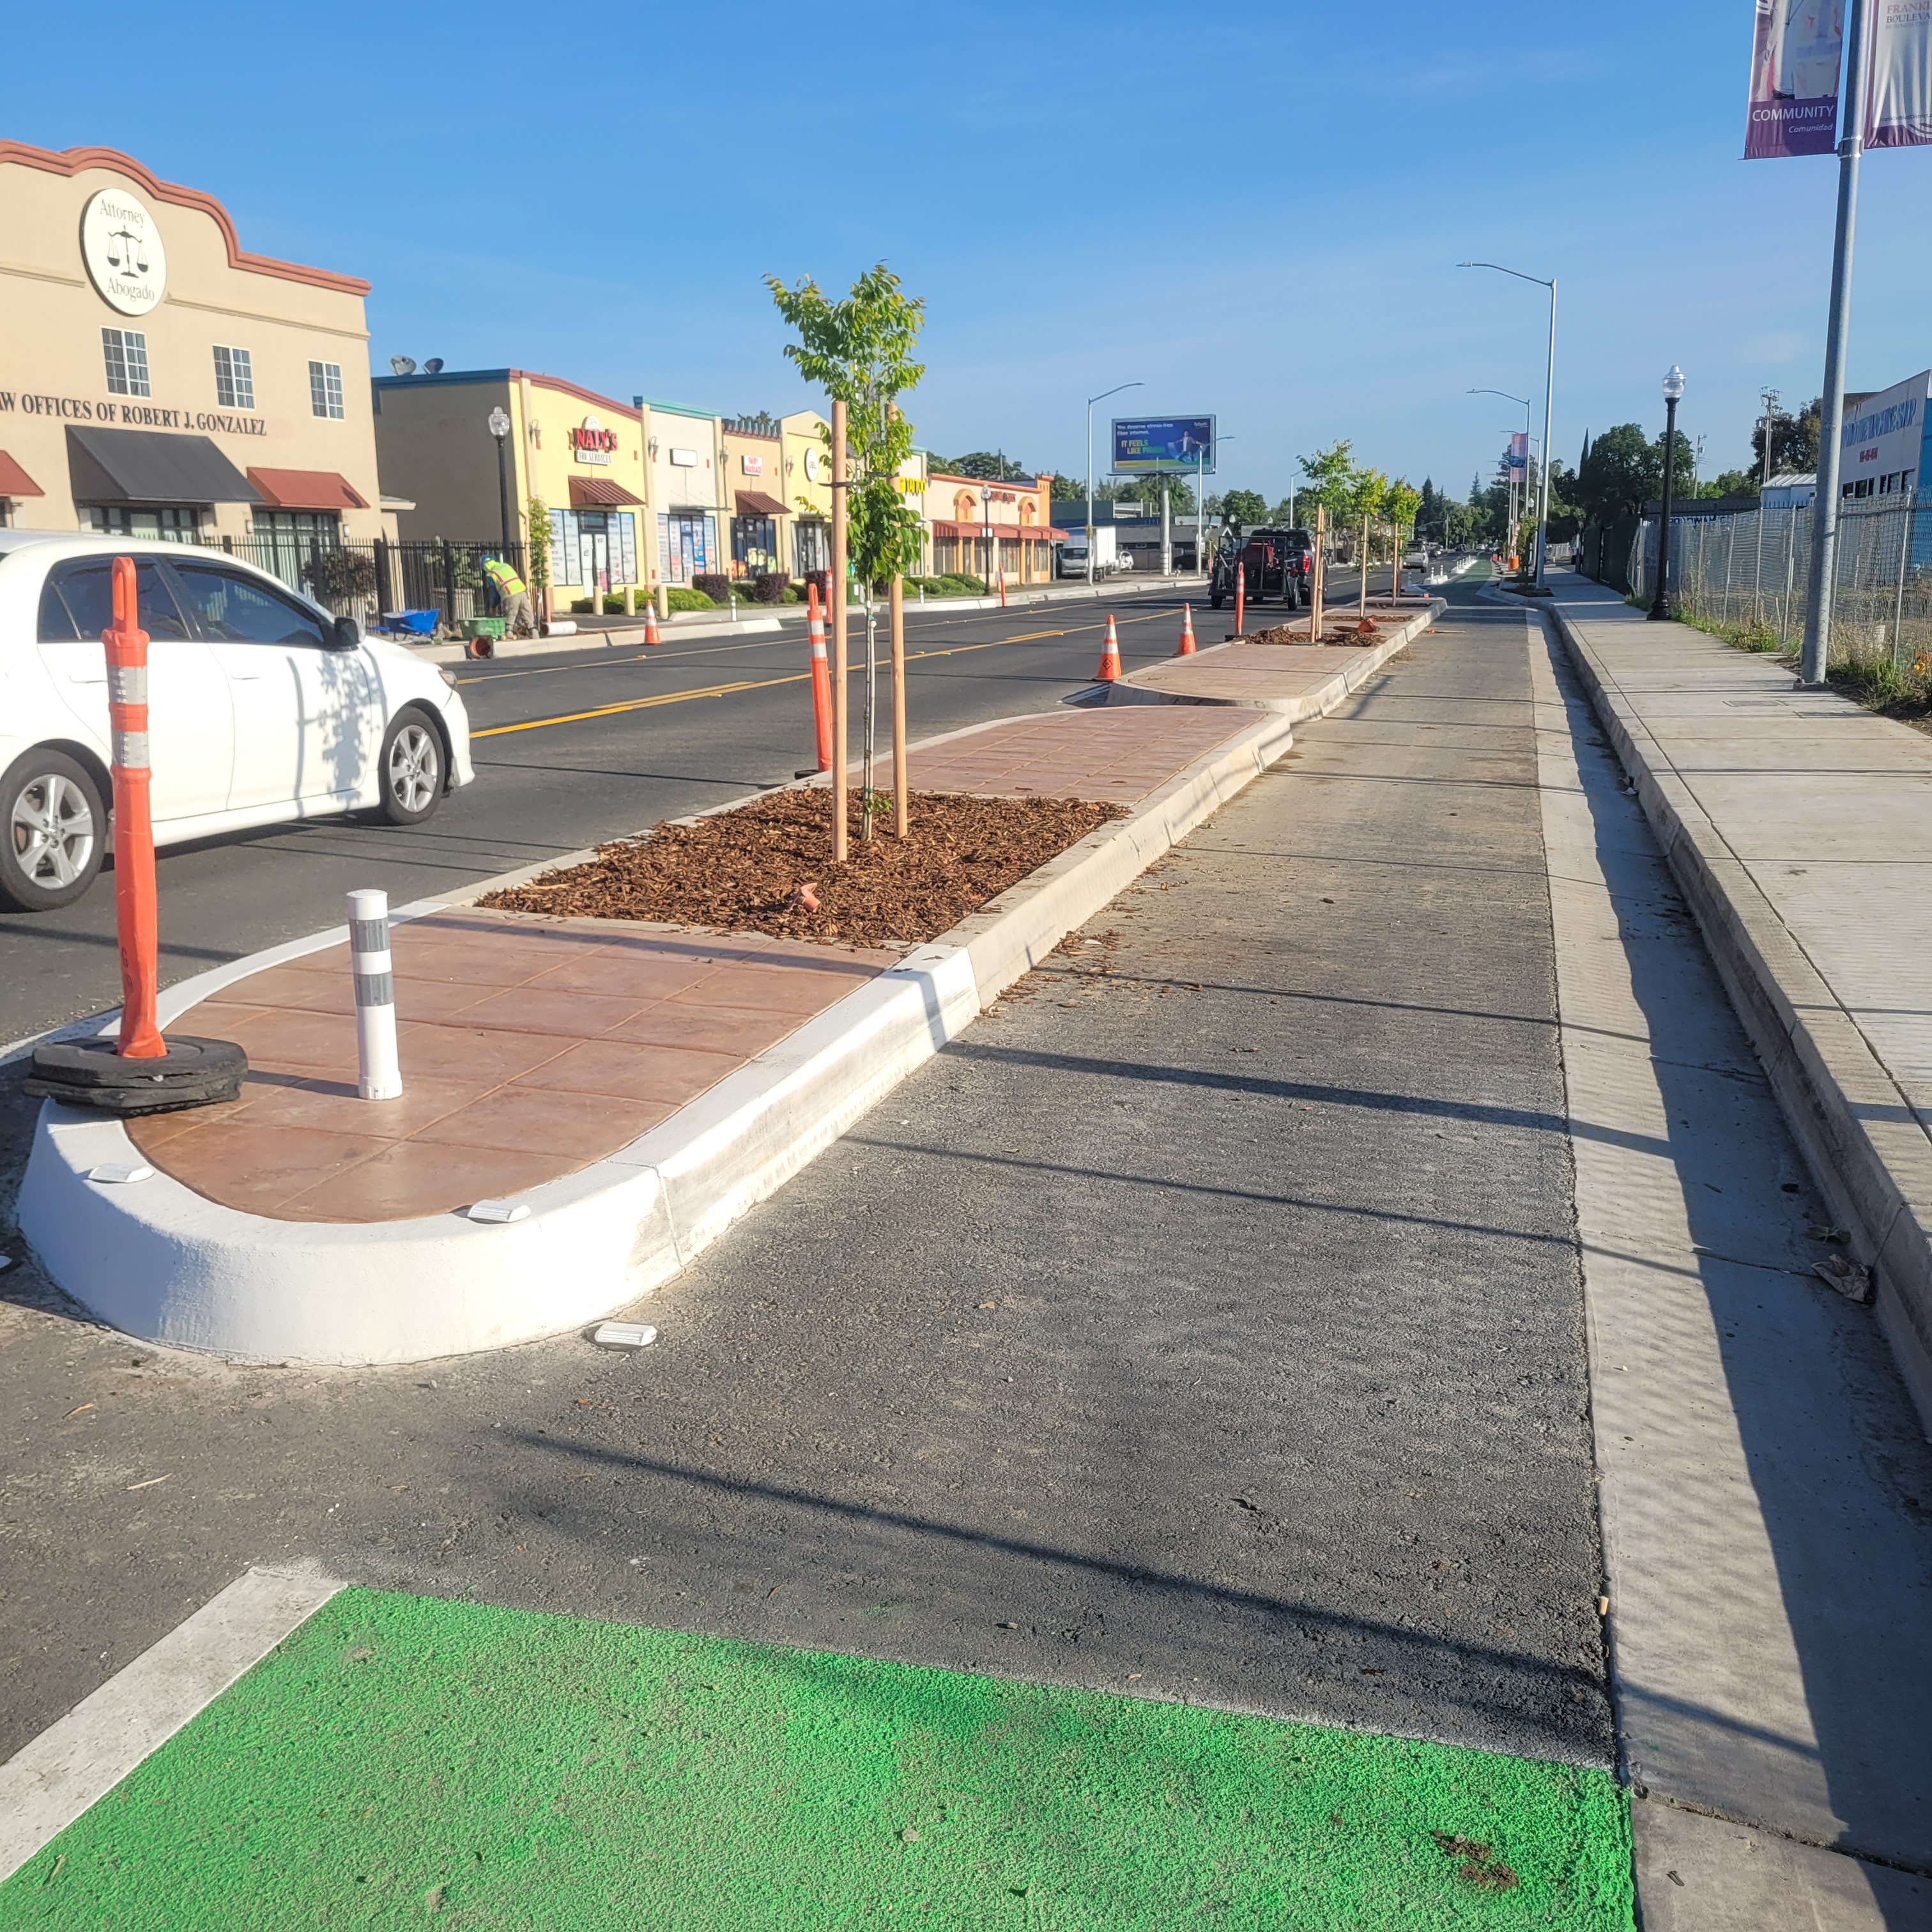
Franklin Complete Streets Phase 1 & 2 Progress Photos

Slide 23
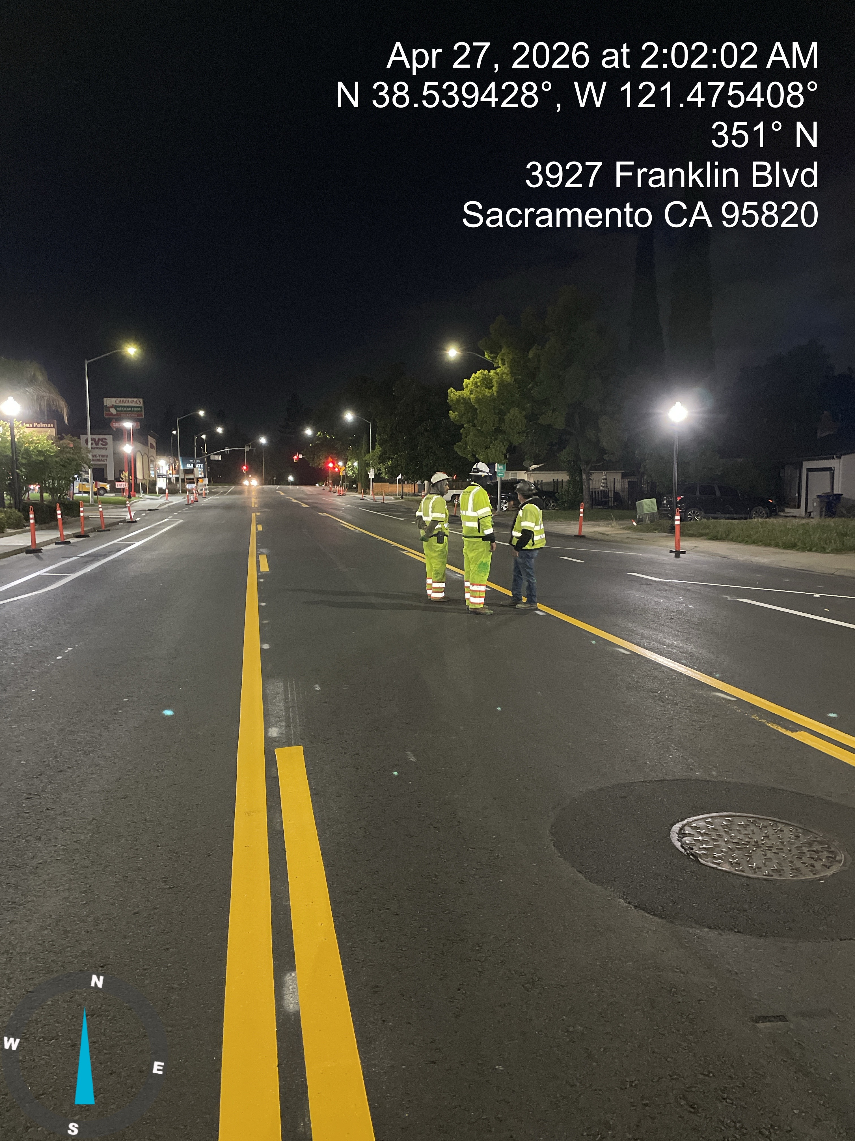
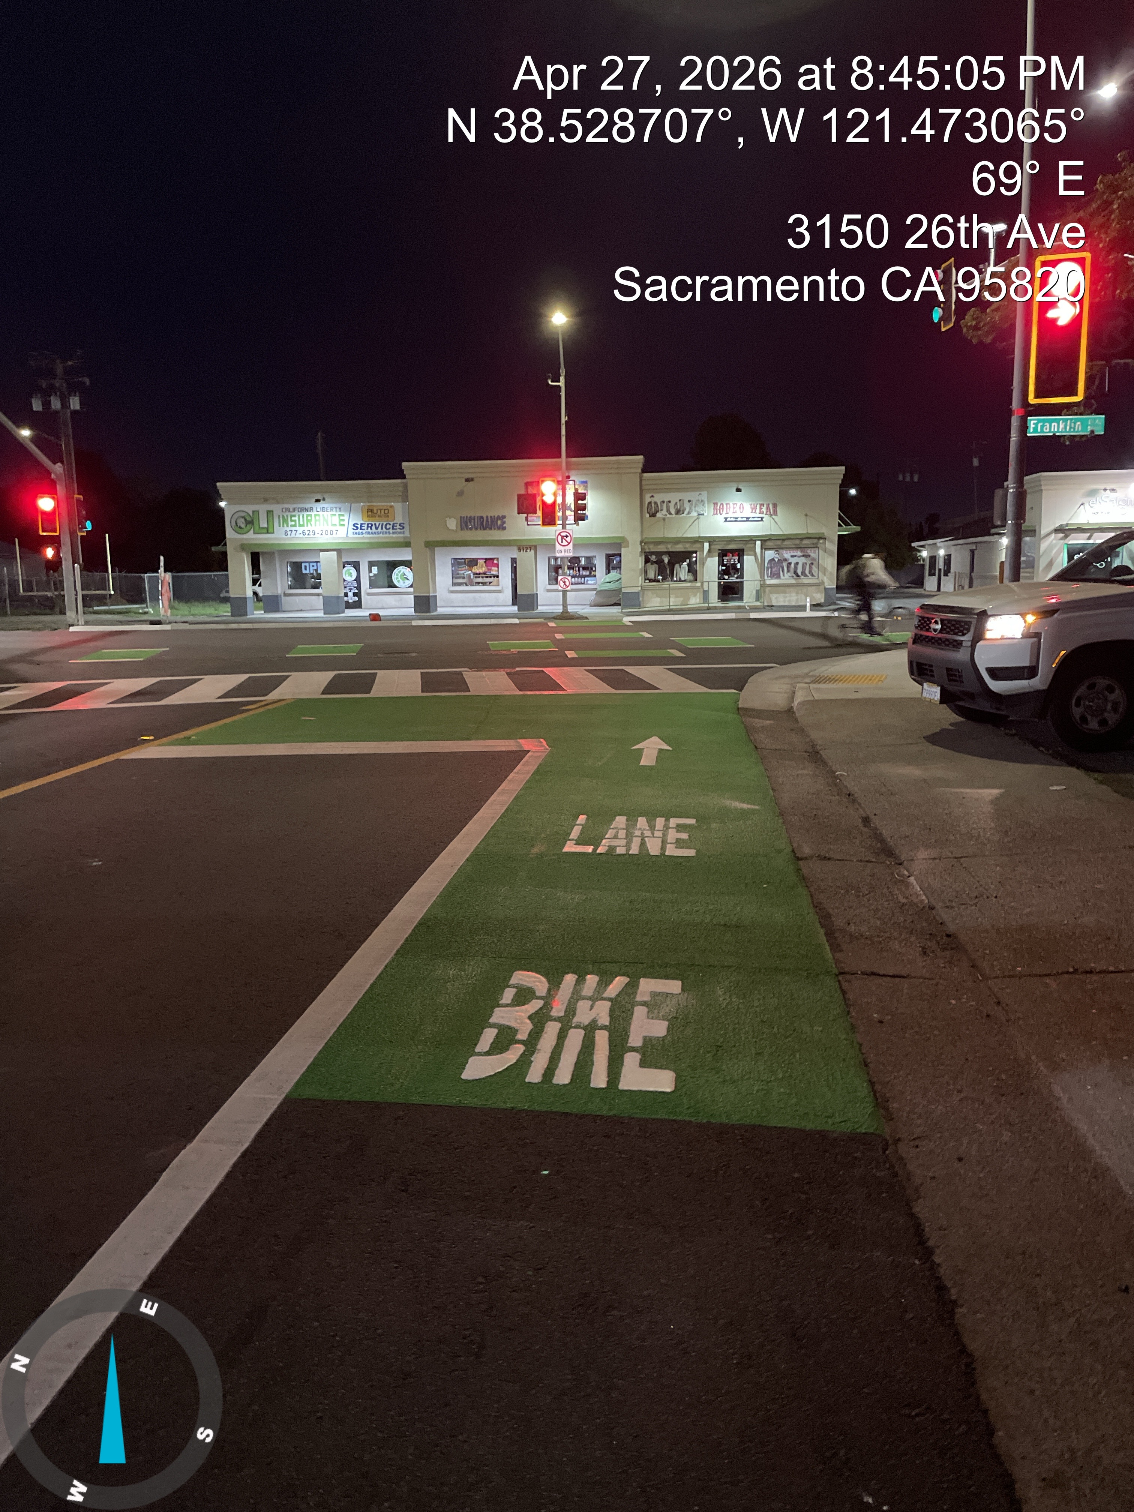
Franklin Complete Streets Phase 1 & 2 Progress Photos

Slide 24
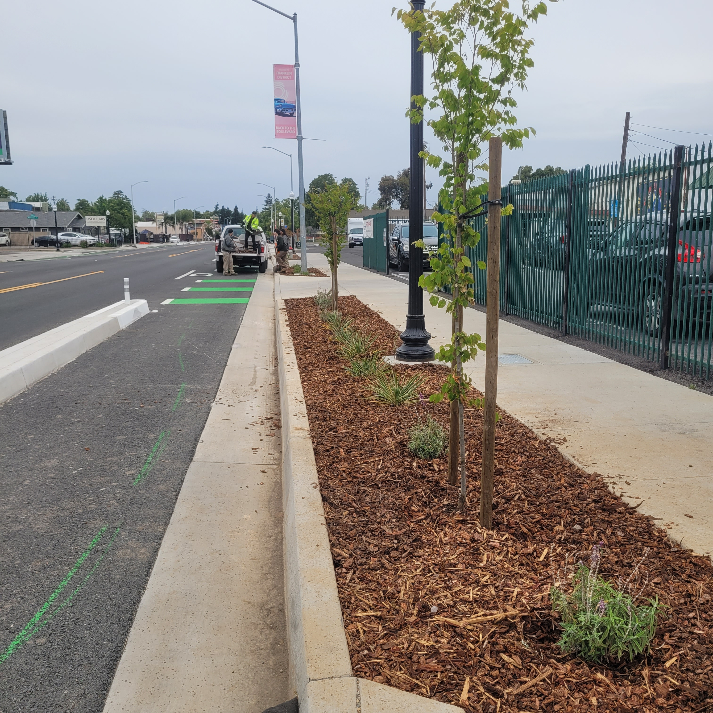
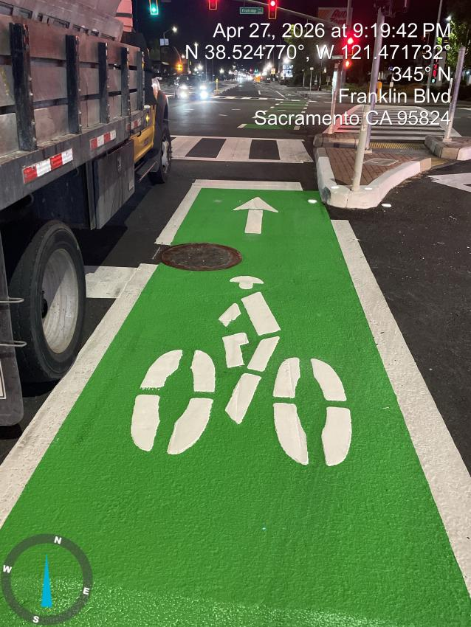
Franklin Complete Streets Phase 1 & 2 Progress Photos

Slide 25
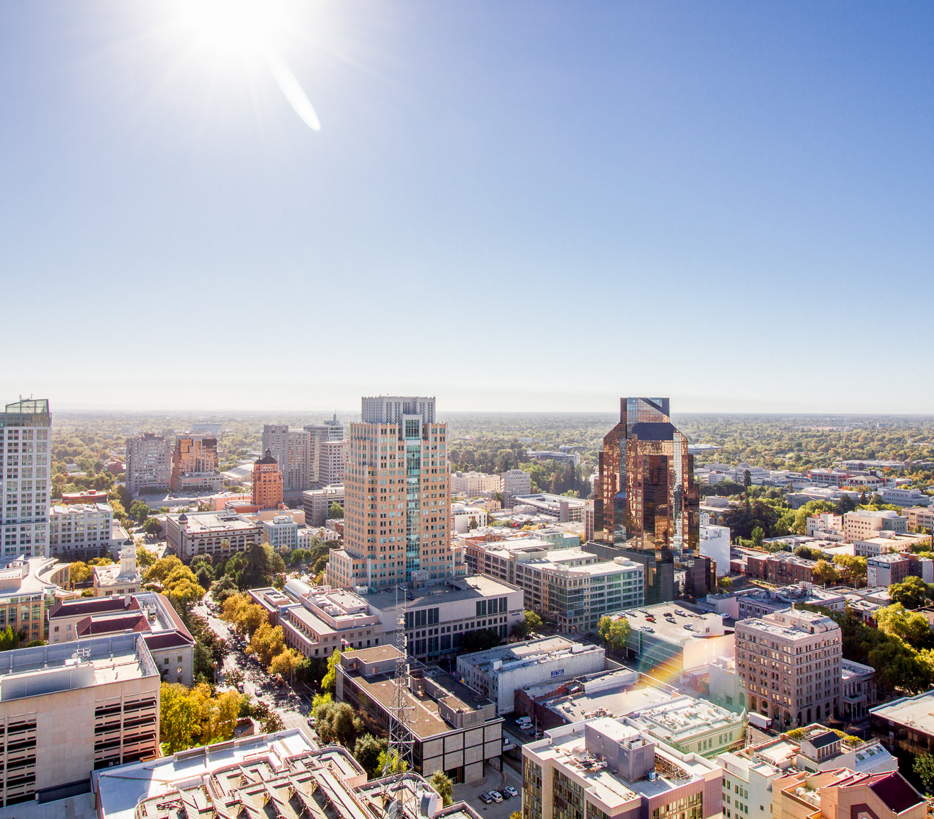
Questions?
Contact:
Philip Vulliet, Supervising Engineer
Quick Build Lead
Transportation Division, Public Works
pvulliet@cityofsacramento.org
Kelli Lacy, Assistant Civil Engineer
FBCS Phase 3 Project Manager
Engineering Services, Public Works
kelacy@cityofsacramento.org

