Slide 1
Social Security: With You Through Life’s Journey…
Produced at U.S. taxpayer expense
Notes:
For more than 80 years, Social Security has helped secure today and tomorrow by providing benefits and financial protection for millions of people throughout their life’s journey.
Social Security touches the lives of every American, both directly and indirectly. As you consider the information that you are about to receive, I encourage you to think about all the ways Social Security has been linked to your life – and the lives of your loved ones.

Slide 2
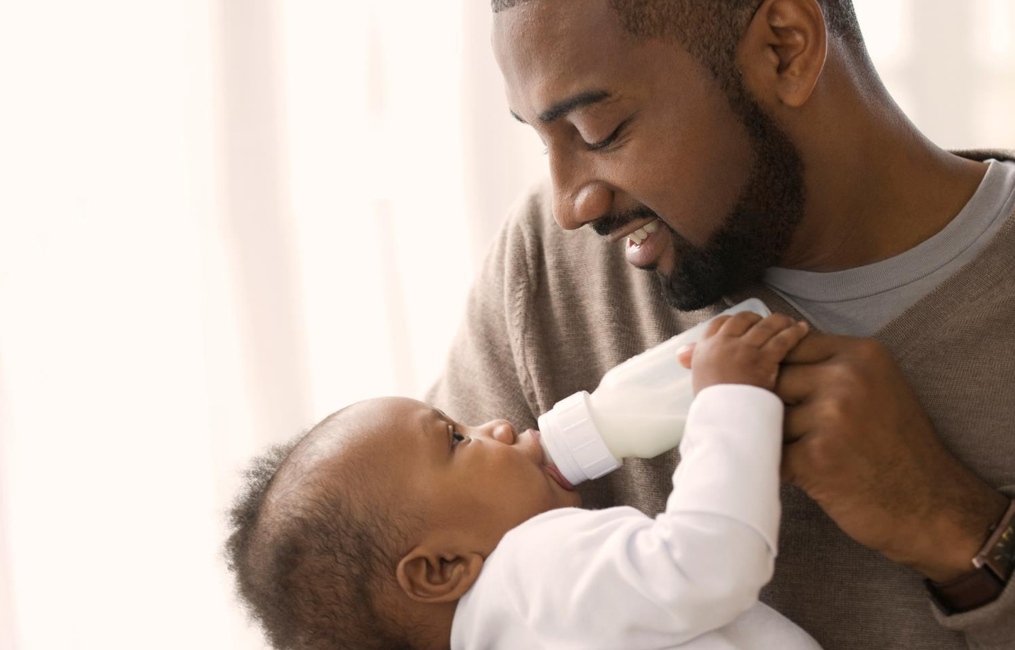
We’re With You Through Life’s Journey
Notes:
Social Security offers much more than just retirement. We provide a safety net of financial protection for your whole family.
We’re with you throughout life’s journey– With retirement, disability, survivors, and other benefits, Social Security is here to help you and millions of others secure today and tomorrow.

Slide 3
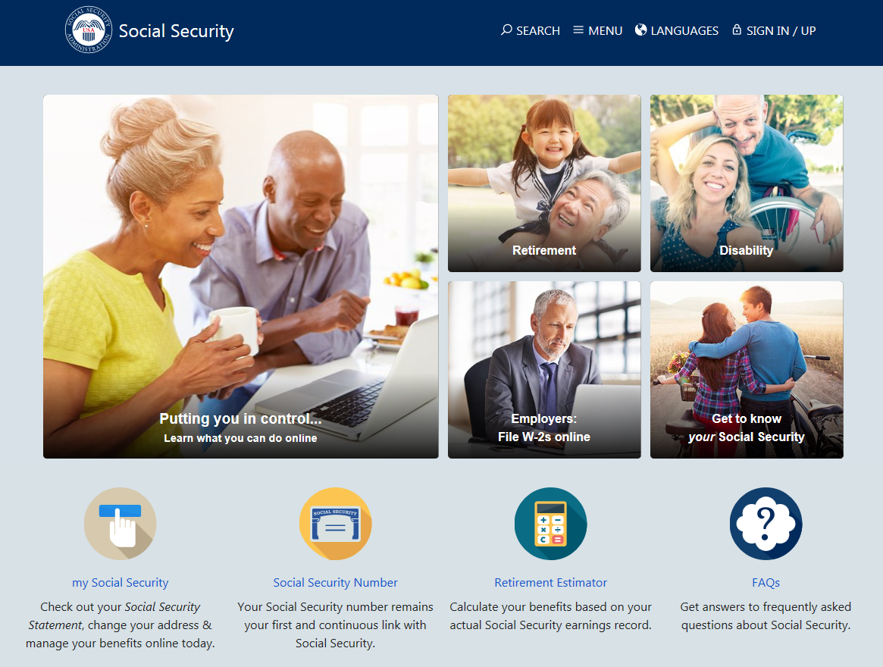
Notes:
The Social Security website is a valuable resource of information about all of Social Security’s programs and is accessible from a computer, tablet and smartphone. We encourage you to use our online retirement planning tools to plan for a secure financial future.

Slide 4
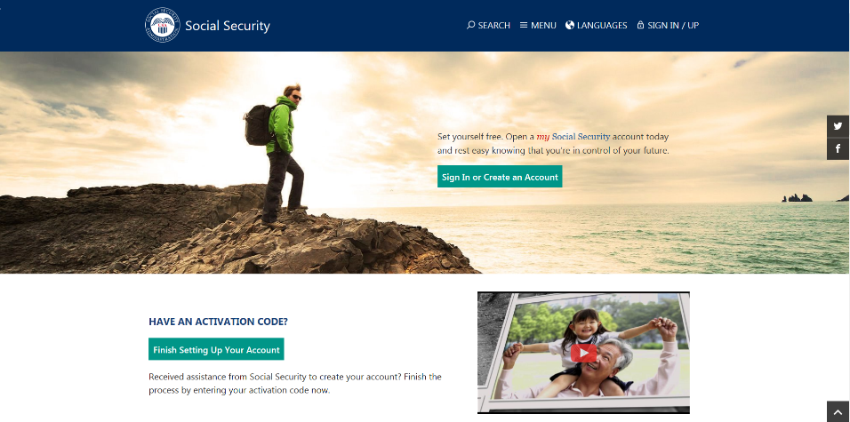
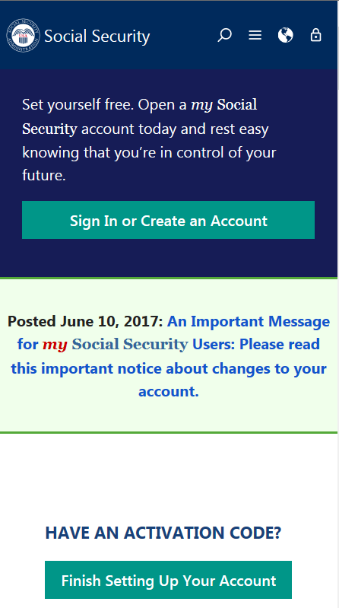
my Social Security
socialsecurity.gov/myaccount
Notes:
my Social Security is a convenient and secure suite of services designed to put you in control of your personal Social Security information, as well as help you manage your benefits when you are ready. Your account gives you the information you need whenever you want. All without calling or visiting a field office.
You can only open a my Social Security account for yourself. You cannot open an account for another person, even if you have his or her written consent. You may be unable to open a my Social Security account if you:
• Blocked electronic access to your personal Social Security information; • Recently moved or changed your name; or • Placed a freeze on your credit report.
Your online my Social Security account provides a variety of information to help you and your family. If you need help setting up your account, we have a 4-minute walkthrough video on our YouTube page.

Slide 5
my Social Security Services
If you do not receive benefits, you can:
Request a replacement Social Security card if you meet certain requirements;
Check the status of your application or appeal;
Get a benefit verification letter as proof that you are not getting benefits;
Get your Social Security Statement to review:
Estimates of your future retirement, disability, and survivor benefits;
Your earnings once a year to verify the amounts that we posted are correct; and
The estimated Social Security and Medicare taxes you’ve paid.
Notes:
So what can you do with a my Social Security account?
Your online my Social Security account provides a wealth of information to help you and your family plan for your financial future.
If you do not receive benefits, you can…

Slide 6
my Social Security Services
If you receive benefits or have Medicare, you can:
Request a replacement Social Security card if you meet certain requirements;
Get a benefit verification letter as proof that you are getting benefits;
Check your benefit and payment information and your earnings record;
Change your address and phone number;
Start or change direct deposit of your benefit payment;
Request a replacement Medicare card; and
Get a replacement SSA-1099 or SSA-1042S for tax season.
Notes:
If you receive benefits or have Medicare, you can…

Slide 7
Enhanced Security for your my Social Security Account
We recently added a second method to check the identification of account holders when you register or sign in.
This is in addition to the first layer of security, your username and password.
You will be able to choose either your cell phone or your email address as your second identification method.
Notes:
Social Security continues to evaluate and improve how we protect what’s important to you. We take this responsibility seriously, and we have a robust cybersecurity program in place to help protect the personal information you entrust to us. Adding additional security measures to safeguard your personal information — but making our services easy to use — is a vital part of keeping you safe and secure.
On June 10, 2017, we added a second method to check your identification when you sign in to my Social Security.
This is in addition to the first layer of security, your username and password.
The next time you sign in, you will be able to choose either your cell phone or your email address as your second identification method.
Using two ways to identify you when you log on will help better protect your account from unauthorized use and potential identity fraud.
We’re committed to using the best technologies and standards available to protect our customers’ data. This new security advancement is just one of the ways we’re ensuring the safety of the resources entrusted to us.
In addition to these security enhancements, we are also upgrading the look and feel of my Social Security, in an effort to create an enhanced customer experience. The my Social Security portal will automatically adjust to the size of the screen and kind of device you are using – such as a tablet, smart phone, or computer. No matter what type of device you choose, you will have full, easy-to-use access to your personal my Social Security account.

Slide 8
Enhanced Security for your my Social Security Account cont.
Each time you sign in to your account, you will complete two steps:
• Step 1: Enter your username and password.
• Step 2: Enter the security code we send by text message or email, depending on your choice (cell phone provider text message and data rates may apply).
If a user does not have a text-enabled cell phone, or does not wish to provide their cell phone number, they will need to use their email address as a second identification method instead.

Slide 9
How to Open a my Social Security Account
1
Visit socialsecurity.gov/myaccount
2
Select: “Sign In or Create an Account.”
Provide some personal information to verify your identity.
3
4
Choose a username and password, then select how you would like to receive a one-time security code to create your account.
No matter what type of device you use, the my Social Security portal will automatically re-adjust to fit the appropriate screen size, providing you full, easy-to-use access to your personal account!
Notes:
To open a my Social Security account, you have to be at least 18 years of age, have a valid e-mail address, a Social Security number, and a U.S. mailing address.
To open your account, go to socialsecurity.gov/myaccount and select “Sign In or Create an Account.”
You will have to provide some personal Social Security information about yourself and give us answers to some questions only you are likely to know to verify your identity.
Next, you choose a “username” and an 8-character “password” to access your online account. This process protects you and keeps your personal Social Security information private.
You will also notice the option of adding an extra level of security to your account. By selecting “Yes, let’s start now” you are prompted to select an additional question to answer. With this feature, you will receive a temporary code via text message each time you attempt to log in. And you will use this code with your account password. Keep in mind that your cell phone provider’s message rates may apply.

Slide 10
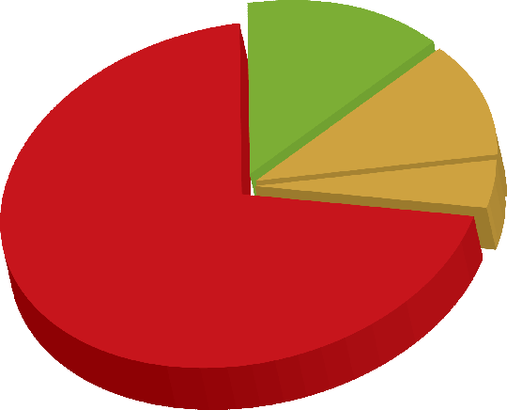
Social Security Beneficiaries
4.4 million
Widows/ Widowers
8.9 million Disabled
Workers, 1.9 million
Dependents
1.9 million
Children
41 million
Retired Workers
3 million
Dependents
12/2017
Notes:
This image illustrates the number of beneficiaries we pay. Currently, more than one in every six people in America is receiving a Social Security benefit. The majority of our beneficiaries are retired.
But Social Security is more than retirement...it is a family protection plan (almost 1/3 of the beneficiaries are disabled, dependents of disabled, or survivors).
Source: https://www.ssa.gov/policy/docs/quickfacts/stat_snapshot/

Slide 11
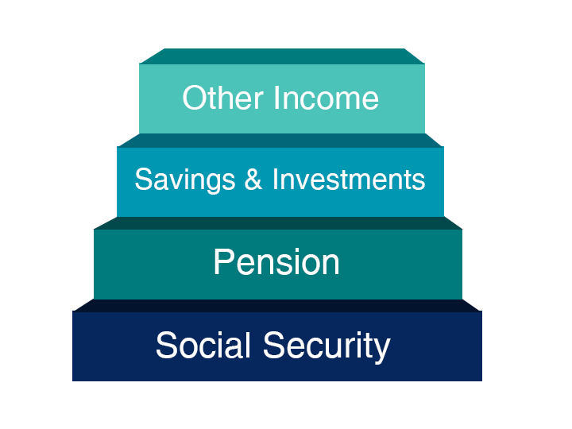
Notes:
You may have heard of the “three-legged stool” of retirement and these days, we like to remind people about investments and other income, as well.
Since Social Security replaces about 40% of preretirement income for the average worker, you need pensions, savings, investments and/or a retirement account such as myRA to have a comfortable retirement.
Again, remember that Social Security was never meant to be the only source of income for people when they retire.

Slide 12
We Wouldn’t Miss Your
Retirement Party
Notes:
When most people think of Social Security, they think of retirement benefits —with good reason. Social Security is a lifeline for most retirees, keeping tens of millions out of poverty.
But we are more than retirement benefits; we offer many online tools like a my Social Security account and the Retirement Estimator to help you plan for your future. When it comes to retirement planning, be sure to check your account for your personal earnings information and estimates of your future benefits to help you plan that retirement party.

Slide 13
How Do You Qualify for Retirement Benefits?
By earning “credits” when you work and pay Social Security taxes
You need 40 credits (10 years of work) and you must be 62 or older
Each $1,320 in earnings gives you one credit
You can earn a maximum of 4 credits per year
Note: To earn 4 credits in 2018, you must earn at least $5,280.

Slide 14
Retirement Estimator
Gives estimates based on your actual Social Security earnings record
You can use the Retirement Estimator if:
You have enough Social Security credits at this time to qualify for benefits and
You are not:
Currently receiving benefits on your own Social Security record;
Waiting for a decision about your application for benefits or Medicare;
Age 62 or older and receiving benefits on another Social Security record; or
Eligible for a Pension Based on Work Not Covered By Social Security.
socialsecurity.gov/estimator
Notes:
You can use the online Retirement Estimator at www.socialsecurity.gov/estimator to get immediate and personalized benefit estimates to help you plan for your retirement.
It’s a convenient, secure and quick financial planning tool.
The Retirement Estimator, is an interactive tool that allows you to create “what if” scenarios.
You can, for example, change your “stop work” dates or “expected future earnings” to create and compare different retirement options.

Slide 15
How Social Security Determines Your Benefit
Benefits are based on earnings
Step 1 -Your wages are adjusted for changes in wage levels over time
Step 2 -Find the monthly average of your 35 highest earnings years
Step 3 -Result is “average indexed monthly earnings”

Slide 16
2018 Retirement Benefit Formula
$
If your average monthly earnings are = $5,500
Then your monthly benefit would be = $2,260
Average Monthly Earnings = $5,500
90% of First.................................................... $895 is $805
32% of Earnings over $895 through $5,397... $4,502 is $1,440
($5,397-$895=$4,502)
15% of Earnings over $5,397........................ $103 is $15
$5,500 is $2,260
*Payments rounded to whole dollar amounts
Notes:
Source: https://www.ssa.gov/OACT/COLA/piaformula.html

Slide 17
Online Calculators
WEP
Online
Calculator
Life Expectancy
Retirement
Earnings Test
Early or Late
Benefits for Spouses
GPO
Quick
Estimator
Detailed
Age
Notes:
We offer 11 different calculators to help you with your retirement planning.

Slide 18
What Is the Best Age to Start Receiving Social Security Retirement Benefits?
Age You Choose to Start Receiving Benefits
Note: This example assumes a benefit of $1,000 at a full retirement age of 66
Notes:
Choosing when to retire is an important and personal decision. Financial experts say you’ll need 70-80% of your preretirement income to have a comfortable retirement. You’ll want to choose a retirement age based on your circumstances so you’ll have enough income when you need it.
I encourage you to read our When To Start Receiving Retirement Benefits fact sheet in its entirety. You can find it by searching our Publications page at SocialSecurity.gov/pubs.

Slide 19
Year of Birth | Full Retirement Age | A $1000 retirement benefit taken at age 62 would be reduced by | A $500 spouse benefit taken at age 62 would be reduced by
1943-1954 | 66 | 25% | 30%
1955 | 66 and 2 months | 25.83% | 30.83%
1956 | 66 and 4 months | 26.67% | 31.67%
1957 | 66 and 6 months | 27.5% | 32.5%
1958 | 66 and 8 months | 28.33% | 33.33%
1959 | 66 and 10 months | 29.17% | 34.17%
1960 + | 67 | 30% | 35%

Slide 20
Working While Receiving Benefits
If you are | You can make up to | If you earn more, some benefits will be withheld
Under Full Retirement Age | $17,040/yr. | $1 for every $2
The Year Full Retirement Age is Reached | $45,360/yr. before month of full retirement age | $1 for every $3
Month of Full Retirement Age and Above | No Limit | No Limit
Note: If some of your retirement benefits are withheld because of your earnings, your benefits will be increased starting at your full retirement age to take into account those months in which benefits were withheld.
Notes:
The first thing we recommend is that you visit SocialSecurity.gov/pubs and search for the publication entitled, How Work Affects Your Benefits. It explains the rules you must follow in order to avoid an overpayment, and it gives some great examples for different scenarios that could apply to your individual situation.

Slide 21
What Income Counts?
Gross Wages from employment and/or
Net Earnings from self employment
Income that Does NOT Count as Earnings:
Inheritance payments
Pensions
Income from investments
Interest and dividends
Capital gains
Other sources

Slide 22
Medicare
Part A = Hospital Insurance
Part B = Medical Insurance
Part C = Medicare Advantage Plans
Part D = Prescription Drug Plans
Visit Medicare.gov for details
Notes:
Medicare is our country’s health insurance program for people age 65 or older. People younger than age 65 with certain disabilities, or permanent kidney failure, or amyotrophic lateral sclerosis (Lou Gehrig’s disease), can also qualify for Medicare.
Medicare has 4 parts:
1. Part A is Hospital Insurance which covers most inpatient hospital expenses. The 2018 deductible for Part A is $1,340.
2. Part B is Medical Insurance which covers 80% of doctor bills & other outpatient medical expenses after your first $183 in approved charges. The 2018 standard monthly premium is $134. There is no monthly premium for Part A if you are insured for retirement benefits. After you retire, your health insurance may require for Medicare to pay first. Many supplemental plans require you to sign up for Medicare Part B. The Medicare premium most beneficiaries pay represents 1/4 of the actual cost, and the Federal government covers the balance of the cost.
3. Part C involves the Medicare Advantage Plans, which are health plan options offered by Medicare-approved private insurance companies . When you join a Medicare advantage plan, you can get the benefits and services covered under Part A, Part B, and in most plans, Part D.
4. Part D is Medicare Prescription Drug Coverage, which covers a major portion of your prescription drug costs. Your out-of-pocket costs—monthly premiums, annual deductible and prescription co-payments—will vary by plan. You enroll with a Medicare-approved prescription drug provider, not by contacting Social Security. Each Medicare Advantage plan can charge different out-of-pocket costs, but they must follow rules established by Medicare. Medicare-approved prescription drug plans cover a major portion of your prescription drug costs.

Slide 23
Medicare
Eligibility
Age 65
ALS
Kidney failure
After 24 months of SSDI
Notes:
If an audience member asks about Medicare based on exposure to environmental health hazard, provide this link: ssa.gov/OP_Home/ssact/title18/1881A.htm.

Slide 24
Medicare
Enrollment
Initial Enrollment Period
Begins 3 months before your 65th birthday and ends 3 months after that birthday
Special Enrollment Period
If 65 or older and covered under a group health plan based on your – or your spouse’s – current work.
General Enrollment Period
January 1 – March 31
Notes:
Medicare has three enrollment periods:
Initial Enrollment Period-- your initial enrollment period has a 7-month enrollment period. It begins three months before your 65th birthday, includes the month you turn age 65, and ends three months after that birthday.
Special Enrollment Period-- If you are age 65 or older, you or your spouse are still working and you are covered under a group health plan based on that current employment, you may not need to apply for Medicare medical insurance (Part B) at age 65. You may qualify for a "Special Enrollment Period" (SEP) that will let you sign up for Part B a the time you retire.
General Enrollment Period - If you didn't sign up for Part A and/or Part B (for which you must pay premiums) when you were first eligible, and you aren’t eligible for a Special Enrollment Period, you can sign up during the General Enrollment Period between January 1–March 31 each year. You may have to pay a late enrollment penalty for as long as you have Part B coverage.

Slide 25
Medicare Part B Initial Enrollment Period
If you enroll in this month of your initial enrollment period: | Then your Part B Medicare coverage starts:
One to three months before you reach age 65 | The month you reach age 65
The month you reach age 65 | One month after the month you reach age 65
One month after you reach age 65 | Two months after the month of enrollment
Two or three months after you reach age 65 | Three months after the month of enrollment
Notes:
This chart shows when your Medicare will become effective if you apply during your initial enrollment period.
If you apply during the 3-month window prior to the month you turn age 65, your Medicare kicks in the 1st day of the month you reach age 65.

Slide 26
The standard Part B premium for 2018 is $134.00.
If you’re single and file an individual tax return, or married and file a joint tax return:
Modified Adjusted Gross Income | Part B monthly premium amount | Prescription drug coverage monthly premium amount
Individuals with a MAGI of $85,000 or less Married couples with a MAGI of $170,000 or less | 2018 standard premium $134.00 | Your plan premium
Individuals with a MAGI above $85,000 up to $107,000 Married couples with a MAGI above $170,000 up to $214,000 | Standard premium + $53.50 | Your plan premium + $13.00
Individuals with a MAGI above $107,000 up to $133,500 Married couples with a MAGI above $214,000 up to $267,000 | Standard premium + $133.90 | Your plan premium + $33.60
Individuals with a MAGI above $133,500 up to $160,000 Married couples with a MAGI above $267,000 up to $320,000 | Standard premium + $214.30 | Your plan premium + $54.20
Individuals with a MAGI above $160,000 Married couples with a MAGI above $320,000 | Standard premium + $294.60 | Your plan premium + $74.80
Notes:
HSA Information: You should not have an HSA if you are enrolled in Medicare as there may be negative tax implications. Recommended to contact your tax professional for more information. Source: Medicare.gov

Slide 27
Extra Help Program
Medicare beneficiaries may qualify for Extra Help with their Medicare prescription drug plan costs.
Find out if you qualify at socialsecurity.gov/extrahelp
Notes:
Extra Help is available for beneficiaries with limited resources and income to help pay for the costs related to a Medicare prescription drug plan. These costs include monthly premiums, annual deductibles and prescription co-payments. Extra Help is estimated to be worth about $4,000 per year.

Slide 28
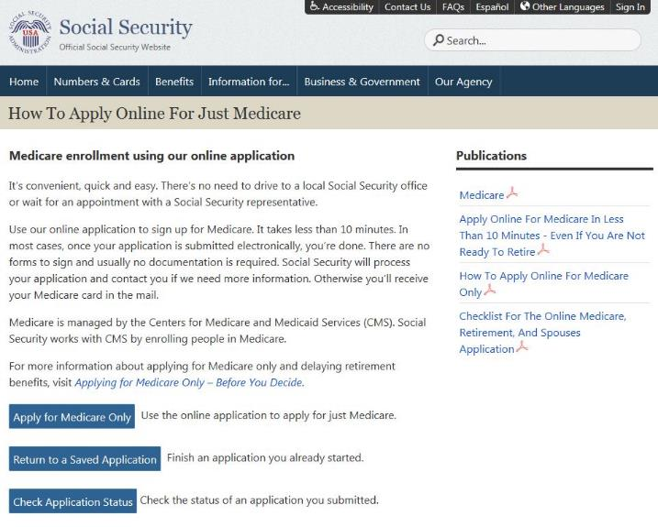
Medicare Applications
If you already have Medicare Part A and wish to add Medicare Part B, simply take or mail forms CMS 40-B and CMS-L564 to your local Social Security office
socialsecurity.gov/medicare/apply.html

Slide 29
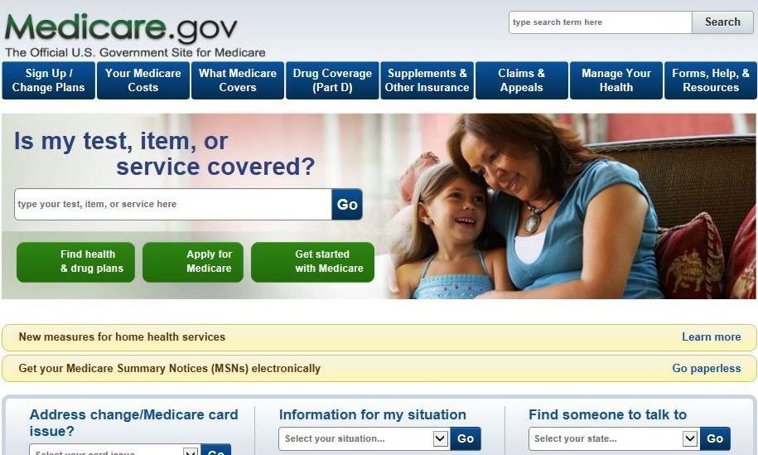
1-800-MEDICARE or Medicare.gov
Notes:
Please keep in mind that although you apply for Medicare by contacting Social Security, and we have some Medicare information on our website, it is actually another federal government agency, Centers for Medicare & Medicaid Services, commonly referred to as “CMS” that administers the program.
CMS is your main source for information regarding Medicare

Slide 30
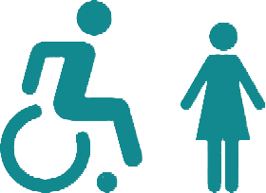
Did You Know?
As of December 2017, 3.1 million dependents of retired workers were receiving 2.2 billion dollars in Social Security benefits each month.
At the same time, 1.7 million dependents of disabled workers were receiving 620 million dollars in monthly Social Security benefits.
socialsecurity.gov/planners

Slide 31
Auxiliary Benefits for Children
A child must have:
A parent who’s disabled or retired and entitled to Social Security benefits; or
A parent who died after having worked long enough in a job where they paid Social Security taxes.
The child must also be:
Unmarried;
Younger than age 18;
18-19 years old and a full-time student (no higher than grade 12); or
18 or older and disabled. (The disability must have started before age 22.)
Notes:
https://www.ssa.gov/pubs/EN-05-10085.pdf
Your child can get benefits if they’re your biological child, adopted child, or dependent stepchild. (Sometimes, your child could also be eligible for benefits on their grandparents’ earnings.)

Slide 32
Spousal Benefits
Benefit is 50% of worker’s unreduced benefit
Reduction for early retirement
If spouse’s own benefit is less than 50% of the worker’s, the benefits are combined
Does not reduce payment to the worker
Notes:
https://www.ssa.gov/planners/retire/yourspouse.html

Slide 33
Year of Birth | Full Retirement Age | A $1000 retirement benefit taken at age 62 would be reduced by | A $500 spouse benefit taken at age 62 would be reduced by
1943-1954 | 66 | 25% | 30%
1955 | 66 and 2 months | 25.83% | 30.83%
1956 | 66 and 4 months | 26.67% | 31.67%
1957 | 66 and 6 months | 27.5% | 32.5%
1958 | 66 and 8 months | 28.33% | 33.33%
1959 | 66 and 10 months | 29.17% | 34.17%
1960 + | 67 | 30% | 35%
Notes:
Source: https://www.ssa.gov/oact/quickcalc/earlyretire.html

Slide 34
Benefits for Divorced Spouses
You can receive benefits on your ex-spouse's record (even if he or she has remarried) if:
You are unmarried;
You are age 62 or older;
Your ex-spouse is entitled to Social Security retirement or disability benefits; and
The benefit you are entitled to receive based on your own work is less than the benefit you would receive based on your ex-spouse's work.
Note: Marriage must have lasted 10 years or longer
Notes:
https://www.ssa.gov/planners/retire/yourdivspouse.html

Slide 35
Deemed Filing
If you become eligible for Social Security benefits both as a retiree and as a spouse (or divorced spouse), and you want to go ahead and claim your benefits, you must file for both benefits.
Applies at any age for people who turned age 62 after January 1, 2016.
Note: There are two exceptions.
socialsecurity.gov/planners/retire/deemedfaq.html
Notes:
You may have heard or read about the various filing strategies available to married couples, when it comes to Social Security retirement and spousal benefits. Due to a change in the law, some of those options are changing.
The first change in the law says that now, if you become eligible for Social Security benefits both as a retiree and as a spouse (or divorced spouse), and you want to go ahead and claim your benefits, you must file for both benefits.
This is called “deemed filing,” and it used to apply only prior to Full Retirement Age. Based on the law change, deemed filing now applies at any age for people who turned age 62 after January 1, 2016.
However, there are two exceptions to the deemed filing provision:
Child-in-Care Benefits: When a beneficiary is entitled to spousal benefits based on the child-in-care requirements and is eligible for retirement benefits, he or she may delay filing for the retirement benefit.
Receiving Both Disability And Spouse’s Benefits: When a beneficiary is entitled to disability and spouse’s benefits, he or she may delay filing for retirement benefits. If the disability benefits terminate before converting to retirement benefits, deemed filing applies in the month of termination of the disability benefit.
You can find more details about this at ssa.gov/planners/retire/deemedfaq.html.

Slide 36
Voluntary Suspension
If you take your retirement benefit and then ask to suspend it to earn delayed retirement credits, your spouse or dependents (excluding divorced spouses) generally will not be able to receive benefits on your Social Security record while your own benefits are suspended.
socialsecurity.gov/planners/retire/suspendfaq.html
Notes:
The second change in the law involves what we call “voluntary suspension.”
If you take your retirement benefit and then ask to suspend it to earn delayed retirement credits, your spouse or dependents (excluding divorced spouses) generally will not be able to receive benefits on your Social Security record while your own benefits are suspended.
In addition, you will not be able to receive benefits on anyone else’s record during that time.
We know that some of these rules can be confusing, so we encourage you to visit our website for a comprehensive explanation and see some specific examples that illustrate how this plays out for married couples.
Visit ssa.gov/planners/retire/suspendfaq.html for information about voluntarily suspending your benefits.

Slide 37
We’re There If You
Lose Your Soulmate

Slide 38
Survivor Eligibility Factors
Child | Can receive benefit if not married and is under age 18 (or under age 19 if still in high school)
Disabled Child | Can receive benefits beyond age 18 if not married and was disabled before age 22
Widow / Widower | Can get full benefits at full retirement age – or reduced benefits at age 60 – or as early as age 50 if disabled – or at any age if caring for child under 16 or a disabled child
Notes:
Generally, you cannot get widow’s or widower’s benefits if you remarry before age 60. But remarriage after age 60 (or age 50 if you are disabled) will not prevent you from getting benefit payments based on your former spouse’s work. Also, at age 62 or older, you may get benefits based on your new spouse’s work, if those benefits would be higher.

Slide 39
Survivor Benefits
When you pass away, your surviving spouse can:
Receive 100% of your full benefit if full retirement age; or
At age 60, receive 71.5% of your full benefit and increases each month you wait up to 100% if you start at full retirement age; or
Claim survivor benefits at any age between 60 and full retirement age.

Slide 40
Other Survivor Benefits
Parents’ Benefits – For a parent who is age 62 and was receiving at least one-half of his or her financial support from the son or daughter who died.
Lump Sum Death Payment – A surviving spouse or child may receive a special lump-sum death payment of $255.00 if they meet certain requirements.
socialsecurity.gov/survivors
Notes:
For more information, go to SocialSecurity.gov and type in lump-sum death payment https://www.ssa.gov/planners/survivors/ifyou7.html

Slide 41
Spouse (living) benefits
Survivor (death) benefits
Can start from age 62 to Full Retirement Age (FRA)
50% at FRA or less if you start prior to FRA (reduction for each month you take it early)
Divorced spouses qualify if marriage lasted at least 10 years and other conditions are met
Can start from age 60 to Full Retirement Age (FRA)
71.5% at age 60 and increases each month you wait, up to 100% if you start at FRA
Divorced spouses qualify if marriage lasted at least 10 years and other conditions are met

Slide 42
We’ll Be Here For Your Family In The Future

Slide 43
Who Pays for Social Security?
Notes:
Social Security is an intergenerational transfer system: today’s workers help pay for current retirees’ and other beneficiaries’ benefits, not their own future benefits.
There’s no account set aside with your name and contributions on it.

Slide 44
Birth Rates
Source: 2017 Trustees Report Table V.A1.
Notes:
The fertility rate in 1920 was about 3.2 children for all women of childbearing age. However, the rate declined dramatically during the depression.
Then, after World War II, a major increase in the fertility rate took place. We know the people born during that time of increase as the baby boomer generation.
But since 1960, there has been a major decline in the rate. This means there will be fewer future workers to support this large generation of baby boomer retirees.
Because of the changing demographics, over the years we have seen the ratio of workers to beneficiaries change.
In 1960 there were 5 people working for every 1 person drawing Social Security benefits, but today that radio is about 3 workers for each Social Security beneficiary. By 2035, when the baby boomer generation is in full retirement, there will be approximately 2 workers for each beneficiary.
Source: https://www.ssa.gov/oact/tr/2017/lr5a1.html

Slide 45
Life Expectancy Statistics
A man reaching age 65 today can expect to live, on average, until age 84.3.
A woman turning age 65 today can expect to live, on average, until age 86.6.
And those are just averages. About one out of every four 65-year-olds today will live past age 90, and one out of 10 will live past age 95.
socialsecurity.gov/planners/lifeexpectancy.html

Slide 46
Social Security in the Future
The two Social Security trust funds – Old-Age and Survivors Insurance (OASI) and Disability Insurance (DI) will be able to pay all benefits in full and on time until 2034.
The trust funds have reached the brink of asset reserve depletion in the past, but Congress made substantial modifications to avoid this.
If Congress does not act before 2034, the trust funds will still be able to pay 77 percent of each benefit due.

Slide 47
Applying for Benefits
3 options available to apply:
Online
By phone 1-800-772-1213
At our office
You choose the most convenient option for you!
Note: Child and survivor claims can only be done by phone or in a field office (not online) at this time.

Slide 48
We’re With You Through Life’s Journey

Slide 49
Social Security: With You Through Life’s Journey…
Produced at U.S. taxpayer expense

Slide 50
Q&A session

