Slide 1
CANNABIS STAKEHOLDER MEETING
Sept. 11, 2017
Office of Cannabis Policy
and Enforcement

Slide 2
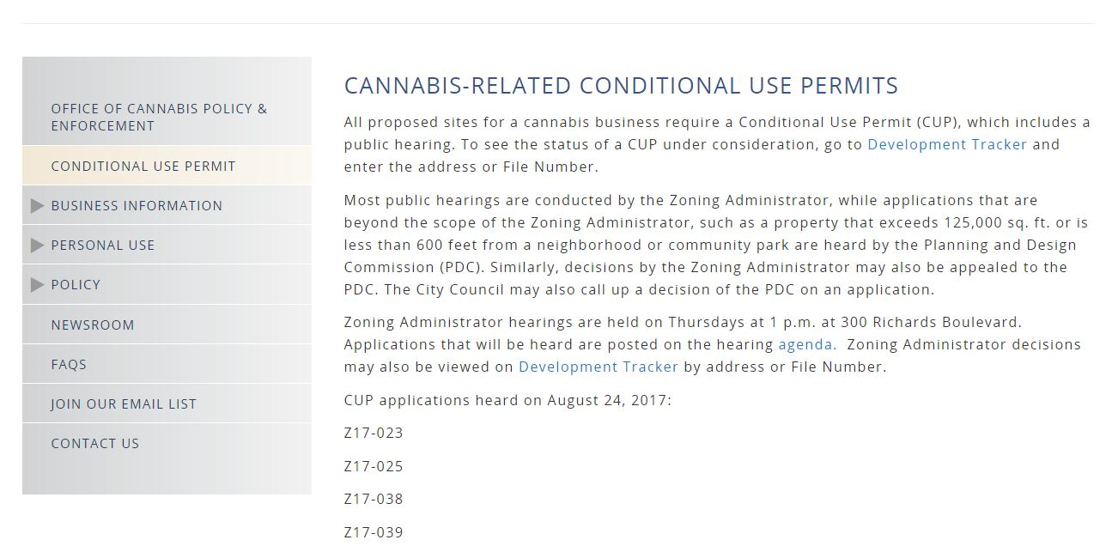
Conditional Use Permit Hearing Schedule and Decisions

Slide 3
Business Operating Permit 2-Step Approval Process
1) Provisional Permit
Non-operational
For those who have yet to complete their build-out
Allow application for State license

Slide 4
BOP 2-Step Hearing Approval Process
2) Final Permit
Following completion of conditions of CUP approval
Issued after an onsite evaluation (walk-through)

Slide 5
BOP 2-Step Hearing Approval Process
Registered Cultivators
No Temporary Permit Granted
Must make swift and continuous progress toward total compliance or BOP will be rejected.

Slide 6
Proposed Distribution Permit Types
A. ADD ON PERMIT to an existing cannabis business permit
Will allow cultivators, manufacturers to transport their own products
B. STAND ALONE PERMIT issued to a different operator
Transport products for others

Slide 7
Not-for-Profit Status
No longer required as of Jan 1, 2018
Applicants can apply as For-Profit entities now

Slide 8
Equity Program Pending Council Approval
Tiered Manufacturing Permit Fees
Remove CUP requirement for smaller manufacturers
Revisit of Background Check (Provide Council with the following options):
Align with State – Interested parties = 20%
Reduce disqualifiers
Expand appealable offenses
Remove background check for employees altogether

Slide 9
TENTATIVE POLICY CALENDAR
Item | L&L | PDC | B&A | Council
Butane Ban | 8/22 | N/A | N/A | 10/3
Cannabis Production: a) Distribution (Title 17); b) Ethanol Exemption; c) Cannabis CUPs; d) Tiered Manufacturing; e) Remove CUP for Testing | 7/25 (Ethanol 8/22) | 9/21 | 10/3 | 10/24
280E | 9/19 | N/A | N/A | N/A
Adult Use Retail (Discussion) | 8/22 | N/A | N/A | N/A
Adult Use Retail (Ordinance) | 10/24 | 10/26 (Admin Penalties: N/A) | 11/7 | 11/21
Dispensaries: a) Add Adult Use Retail; b) Add Delivery; c) Cap on Storefront/Ability to Re-issue Permits; d) Distance Requirement; e) Background Checks; f) Admin Penalties | 7/25 (Admin Penalties 10/24)
Distribution (Title 5) | 10/24 | 10/26 | 11/7 | 11/21
2018
Microbusinesses | TBD | TBD | TBD | TBD
Adult Use – Onsite Consumption | TBD | TBD | TBD | TBD
Adult Use – Temporary Event Permits | TBD | TBD | TBD | TBD
Ancillary/Misc Business Permits | TBD | TBD | TBD | TBD

Slide 10
QUESTIONS
Joe Devlin
Chief of Cannabis Policy and Enforcement
jdevlin@cityofsacramento.org
Zarah Cruz
zcruz@cityofsacramento.org; 916-808-8925
Christine Autio
cautio@cityofsacramento.org; 916-808-4773

