Slide 1


FY2023/24 Close
FY2024/25 Update
FY2025/26 Budget
February 25, 2025

Slide 2
FY24 Year-End Close
FY25 Budget Update
FY26 Budget Update
FY24 Year End
FY25 Budget Update
5-Year Forecast Update / FY26 Budget Gap
Budget Balancing
Pending Factors
Recommendations

Slide 3
FY2023/24 Year End Results
Category | Performance vs Budget ($s in 000s)
Major Tax Revenues | $6.5
City Operations | $7.6
TOTAL | $14.1
Investments Fair Market Gain | $12.7
GRAND TOTAL | $26.8
Investments Fair Market Gain is the one-time repayment of prior year unrealized losses on the City’s investment pool.
Based on FY2023/24 year-end close, the City has $26.8 million in General/Measure U available fund balance ($3.3 million was assumed as fund balance in the Approved Budget forecast).

Slide 4
Fiscal Year 2024/25 Approved Budget
$1.6 Billion All Funds
$847 Million General/Measure U Funds
Supports over 5,000 full-time equivalent employees
Closed $66 Million Funding Gap Without Eliminating Filled Positions

Slide 5
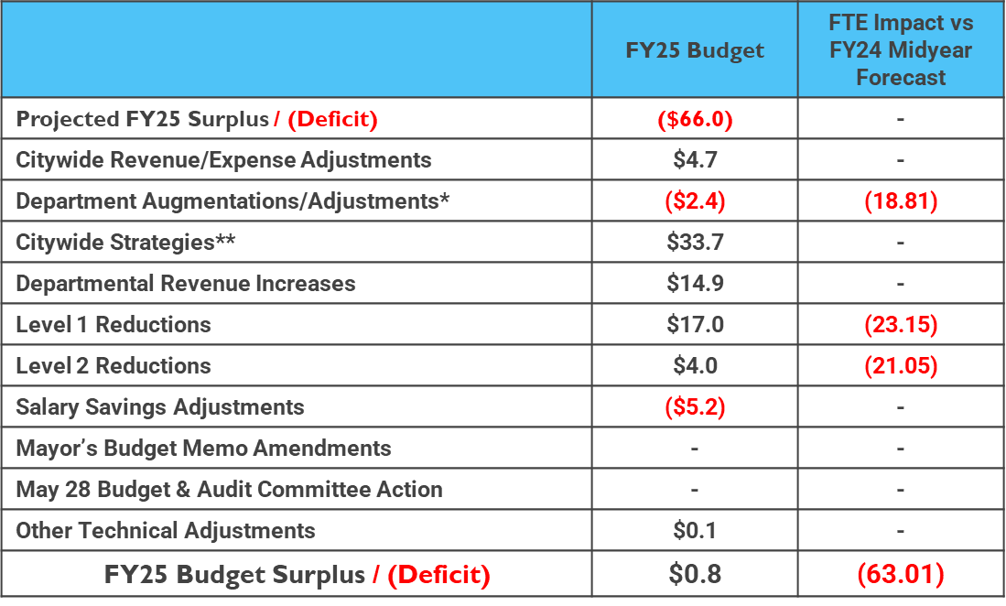
FY2024/25 Budget Balancing

Slide 6
Onetime vs Ongoing Balancing Strategies (millions)
One-time balancing solutions must be made up for in future Fiscal Years

Slide 7
FY 25 – Budget Updates
1% Bradley Burns Sales Tax and Measure U Sales Tax projected below budget.
Property Tax, Transfer Tax, Utility Users Tax, and Cannabis BOT projected above budget.
Departmental revenue projected above budget, additional offset adjustment for YPCE, and 911 facilities repair adjustments.

Slide 8
FY 25 Updates
Revenue Source | FY 24/25 Adjustment (millions)
Sales Tax (1%) | ($4.8)
Sales Tax – Measure U | ($5.9)
Utility Users Tax | $3.0
Property Tax | $2.6
Property Tax In-Lieu of VLF | $0.7
Property Transfer Tax | $2.7
Cannabis BOT* | $0.9
Department Revenues | $3.8
Total Revenue Adj | $3.0
YPCE Offsets | ($0.8)
Measure L True-Up | 0.4
911 Communications Center Repairs | $1.0
Total Expense Adj | $0.6
*Equivalent of 40% will go to Children’s Fund

Slide 9
Property Tax – FY 25 Update ($ millions)

Slide 10
1% Sales Tax – FY 25 Update ($ millions)

Slide 11
Measure U Sales Tax – FY 25 Update ($ millions)

Slide 12
Utility Users Tax – FY 25 Update ($ millions)

Slide 13

5-Year Forecast Update

Slide 14
Forecast Assumptions
Continued economic growth / No recession
Incorporates labor agreement with Local 522 (net G/MU fund neutral)
Included projected HHAP-6 allocation for FY2025/26 of $18.3M (average of prior 3 years homeless services portion)
  On February 24th, the State released HHAP-6 allocations & City of Sacramento allocation was lower than our projection
  If the portion of HHAP-6 for homelessness services is the same as prior years, the G/MU budget impact will be ($5.4M)
Does NOT include potential loss of federal funding

Slide 15
Projected FY 26 Funding Gap ($ millions)
Resources | $861.0
Expenses | ($923.2)
Projected Funding Gap | ($62.2)
To meet our Charter mandate to balance the FY 2025/26 Budget, the City needs to close a projected $62.2 million deficit.

Slide 16
Updated Forecast ($ millions)

Slide 17
FY2025/26 Budget Balancing
Guiding Principles
Focus on defining core services versus instituting across-the-board cuts
Minimize service impacts on residents
Minimize staffing impacts
Budget Instructions
Develop reduction plans to hit a target reduction of 15% net G/MU fund use.
Define service and staffing impact of each strategy
Citywide Strategies
Finance staff will review projects and other citywide budget reduction strategies.

Slide 18
Reduction Strategies
City Manager departments have submitted 138 reduction strategies that have been categorized by service impact and analyzed for staffing impacts. Staff is also analyzing ‘Citywide’ strategies – mostly involving one-time balancing solutions. The full list of options with associated service impacts will be published and provided to Council and the public.
Category | # Strategies | Amount (millions) | Vacant FTE Impact | Filled FTE Impact | Total FTE Impact
Revenue Enhancement | 18 | $16.3 | - | - | 2.0*
Level 1 – Low Impact | 41 | $9.5 | (40.8) | (12.1) | (52.9)
Level 2 – Moderate Impact | 32 | $12.1 | (72.2) | (10.7) | (82.9)
Level 3 – High Impact | 27 | $17.2 | (86.5) | (71.9) | (158.4)
Level 4 – Severe Impact | 20 | $33.0 | (35.8) | (160.7) | (196.5)
TOTAL | 138 | $88.1 | (235.3) | (255.3) | (488.7)
*Additional staff needed to implement certain revenue enhancement strategies

Slide 19
FY 26 Budget Development Calendar

Slide 20
Pending Factors
Federal funding risks
Unfunded pension obligations
Unfunded capital needs
Future of State homelessness program resources
Risk of recession

Slide 21
Recommendations
Approval of Annual Comprehensive Financial Report.
Approval of FY25 Revenue & Expense adjustments (including $3.3M of FY24 fund balance to balance FY25 as included in FY2024/25 Approved Budget forecast).
Use balance of one-time FY24 savings of $23.5 million towards closing the FY26 Budget gap:
FY2025/26 Budget Gap | ($62.2M)
One-Time Balancing Strategy - Use of prior year savings | $23.5M
Feb 24 - HHAP-6 Actual Allocation vs Projection | ($5.4M)
Remaining FY26 Budget Gap | ($44.1M)

Slide 22
Questions & Discussions

