Slide 1
Prepared by the Office of Cannabis Management
CORE Stakeholders Meeting 3:00pm-5:00pm
March 7, 2024
CORE Storefront Dispensary
Listening Session 2

Slide 2
Ground Rules
Respectful space to obtain feedback on a very limited topic
Be concise in your comments and speak on what you want rather than spending time on what you don't want
Wait to ask a question/comment until you're called on and if you've already spoken on the topic, we may call on those who haven't spoken before calling on you
We will be polling for your feedback at the end, you can register your preferences there if you'd rather not speak during this listening session

Slide 3
Purpose of Listening Session
Obtain input from CORE participants on a possible framework for additional storefront dispensary permit opportunities
Next Steps:
OCM will work with City Attorney to draft necessary code changes and resolutions
OCM will draft staff report and schedule for the Law & Legislation Committee

Slide 4
Previously.....
January 23, 2024 - Council directed OCM to develop a proposed framework for the number and method of allocating storefront dispensaries for CORE participants with goal of presenting at L&L in April (See Item 12 on City Clerk's Council Agenda)
February 9, 2024 - First listening session held on optimum number of storefront permits and allocation methods (See "Meetings and Events" on OCM website for recording)

Slide 5
2/9/24 CORE Storefront Survey Results on Allocation Methods
Top three preferred methods of allocating dispensary opportunities
14 – “Qualified” Lottery Process
7 – Date Order Processing Process
6 – “Normal” Lottery Process”

Slide 6
2/9/24 CORE Storefront Survey Results on Permit Numbers
31 attendees responded to “How many storefront dispensaries permits should OCM ask the City Council to make available for CORE?”

Slide 7
CORE Storefront Discussion Roadmap
What are the qualifications/criteria for the “Qualified” Lottery Process?
How long should the storefront dispensaries stay CORE (51% CORE ownership)?
Should the number of CORE storefront dispensary permits dictate the length of CORE ownership?

Slide 8
CORE “Qualified” Lottery Process Recap
Qualified Lottery Process is a blind, random selection process for CORE participants with a minimum and business readiness submittal component.
Step 1: Pre-Lottery application with minimum criteria
Step 2: Lottery application with business readiness qualification submittals
Step 3: Lottery
Step 4: Those selected would start BOP Process

Slide 9
“Qualified” Lottery Process – Business-Readiness Qualifications & Criteria
Potential qualifications and criteria:
A presentation and/or interview of the CORE applicant and their team
Business plan, budget, and business formation documentation
Completion of cannabis business courses/modules/trainings
Demonstrated involvement in the Sacramento Cannabis or CORE community
Fiscal readiness or investment commitment
Experience operating a cannabis business
Experience owning and operating any type of business
Others?

Slide 10
Length of CORE Ownership (51%) and Number of Permits
• 10 years
• 20 years
• In perpetuity

Slide 11
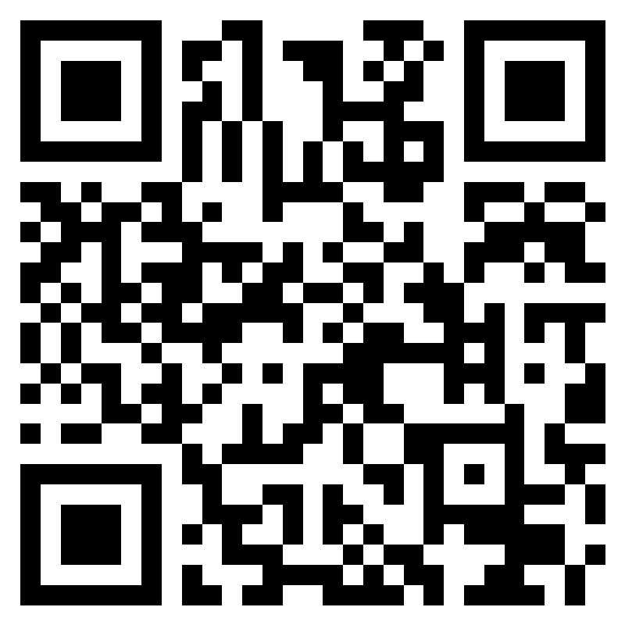
CORE Survey Instructions
Scan QR or use the URL
https://forms.office.com/g/kB8HdPAzgW

Slide 12
CORE Survey
Q3) Please select the qualifications and criteria that you believe OCM should include in the “Qualified" Lottery Process
Please select at most 3 options
A presentation and/or interview by the CORE applicant and their team
Business plan, budget, and business formation documentation
Completion of cannabis business courses/modules/trainings
Demonstrated involvement in the Sacramento Cannabis or CORE community
Funding or investment commitment
Experience operating a cannabis business
Experience owning and operating any type of business
Other

Slide 13
CORE Survey
Q4) How should we evaluate the qualifications and criteria?
Scoring rubric
Complete documentation/criteria/qualification
Other

Slide 14
CORE Survey
Q5) Should the storefront dispensaries remain CORE (51% CORE ownership) for?
• 10 years
• 20 years
• In perpetuity
Q6) Should the number of CORE storefront dispensary permits dictate the length of CORE ownership?
• Yes
• No
Q7) What is your reasoning on whether the number of CORE storefront dispensary permits dictate the length of CORE ownership?
• Text answer

Slide 15
CORE Contact
Phone: (916) 808-8955 Web: SacramentoCore.org
Email: cannabis@cityofsacramento.org

