Slide 1

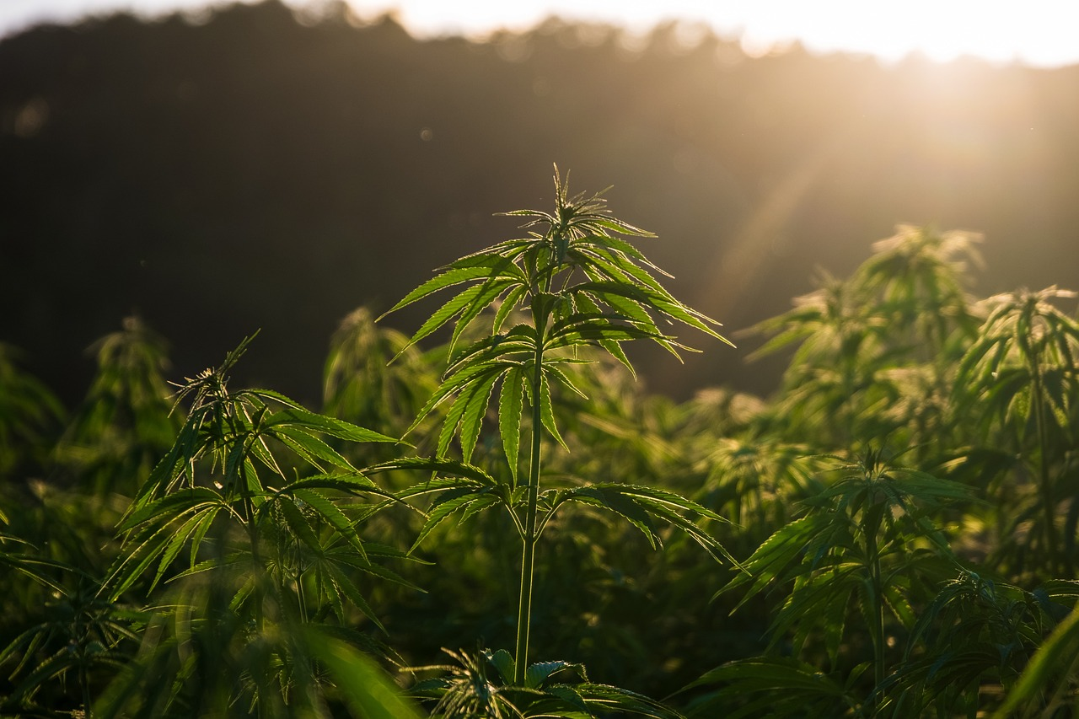
Prepared by the Office of Cannabis Management
CORE Careholders Meeting 2:30pm-4:30pm
January 22, 2026
Cannabis CORE Careholders Meeting

Slide 2
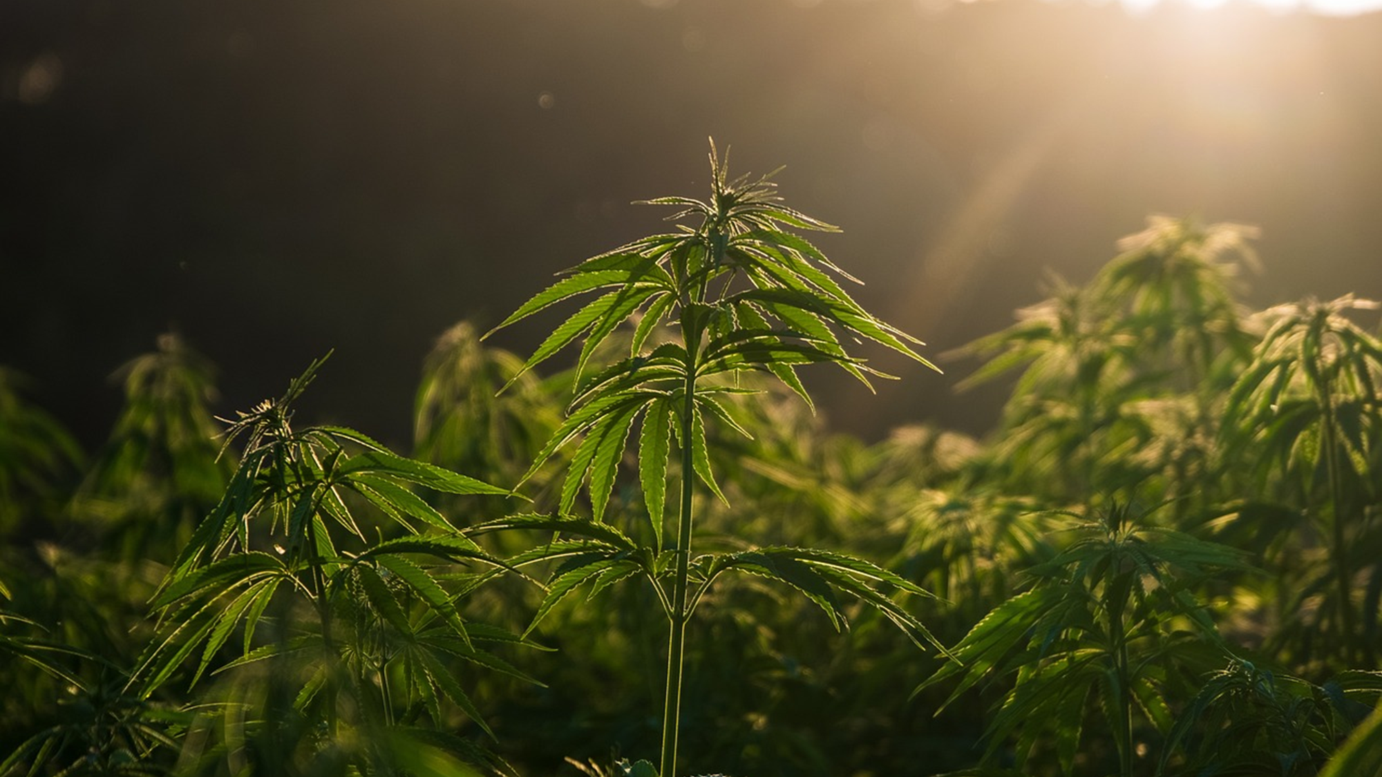

CORE Careholders Meeting
Questions will be taken at the end of the presentation.
Round-table meeting format. Feedback to be kept within 3 mins
Hard stop at 4:00pm, follow-up questions to be responded via email
Presentation will be available on the OCM website

Slide 3
Agenda
Introductions
CORE Program – General Updates
  Equity Week
  CORE Awareness Campaign
  CORE Summit 2026

Slide 4
General Updates

Slide 5

CORE General Updates
Make Green Go
  Equity Week!
  May 9, 2026
  CORE Awareness Campaign
  Video Interviews.
    Will be used for Equity Week Campaign
    Operators can use those for marketing
    Previous media contractor – videos/photos

Slide 6
CORE General Updates
CORE Summit 2026
  Multi day event
  Industry Experts, Operators, Advocates, Policy makers, and more!
  Network and Engage
  Exhibit/Tabling opportunities
Winter Tiered Grant Cycle & Reimbursements
  Grant Agreements via Adobe Sign have been sent.
  Awards sent

Slide 7

CORE General Updates
May 6 – 8, 2026
Registration: Begins March

Slide 8
Launch Industries

Slide 9

Direct Technical Assistance
Local and state application, licensing, and regulatory fees
Legal assistance
Regulatory compliance
Request Assistance: https://launchmycannabiz.com/sacramento-core

Slide 10



Contact
Phone: (916) 808-8955
Web: https://www.cityofsacramento.gov/finance/cannabis-management
Email: cannabis@cityofsacramento.org

