Slide 1

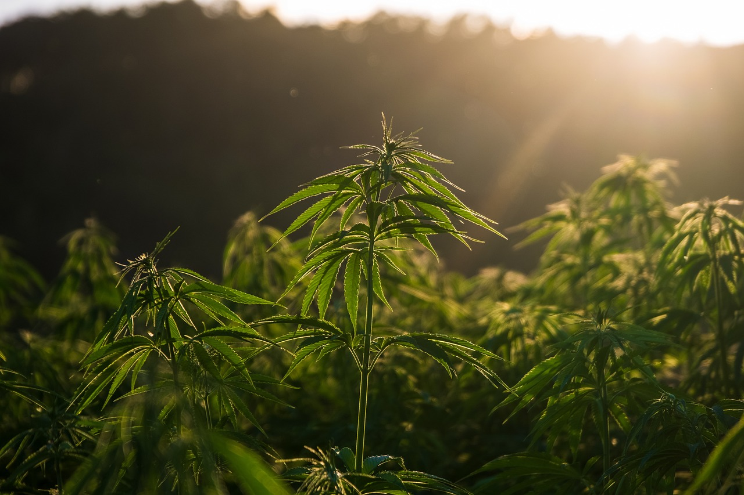
Prepared by the Office of Cannabis Management
CORE Careholders Meeting 2:30pm-4:45pm
September 25, 2025
Cannabis CORE Careholders Meeting

Slide 2


CORE Careholders Meeting
Questions will be taken at the end of the presentation.
Round-table meeting format. Feedback to be kept within 3 mins
Hard stop at 4:00pm, follow-up questions to be responded via email
Presentation will be available on the OCM website

Slide 3
Agenda
Introductions
CORE Program – General Updates
Global Reach Strategies – Dr Ayoka Nurse
Survey & Discussion
Launch Industries – Marques Cameron
Updates and Engagement

Slide 4
General Updates

Slide 5

CORE General Updates
Make Green Go
Equity Week!
Postponed to Spring 2026
Video Interviews.
Will be used for Equity Week Campaign
Can Operators have access to the videos for marketing?
Cannabis Training Program
40 Students have Enrolled to Date
This week’s course: “Building a Strong Cannabis Business Foundation”.

Slide 6
CORE General Updates
Tiered Grant Cycle
Fiscal is now accepting receipts for the upcoming Tiered Grant Cycle
Applications open December 1!
CORE Capital Loan Program
As of January 1, 2026, OCM will pause all new loan applications.

Slide 7

CORE General Updates
May 6 – 8, 2026

Slide 8

Discussion
Social Equity Study
with Dr. Ayoka Nurse, PhD.

Slide 9
Launch Industries

Slide 10

Direct Technical Assistance
Local and state application, licensing, and regulatory fees
Legal assistance
Regulatory compliance
Request Assistance: https://launchmycannabiz.com/sacramento-core

Slide 11



Contact
Phone: (916) 808-8955 Web: https://www.cityofsacramento.gov/finance/cannabis-management
Email: cannabis@cityofsacramento.org

