Slide 1


Prepared by the Office of Cannabis Management
CORE Careholders Meeting 2:30pm-5:00pm
September 25, 2025
Cannabis CORE Careholders Meeting

Slide 2


Agenda
Introductions
CORE Program Updates
Global Reach Strategies – Dr Ayoka Nurse
Survey & Discussion
Launch Industries – Marques Cameron
Updates and Mix
Notes:
Welcome and thank you for joining us for today’s CORE careholder meeting.

Slide 3
CORE Careholders Meeting
Questions will be taken at the end of the presentation.
Round-table meeting format
Hard stop at 4:30pm, follow-up questions to be responded via email
Presentation will be available on the OCM website
Notes:
I want to introduce our team. Myself, Fiona Mattson, Lindsay Brown Fiscal Officer, Al Romero Gibu.
Global Reach Strategies will conduct a survey. If you were at the last careholder meeting, then you are familiar with the process. Dr Nurse wants to hear from you. Your opportunity to share what is working well and what is not working well with CORE
Team Launch is in attendance, Marques Cameron. They have some updates to share and there will be time for engagement at the conclusion of the presentation.

Slide 4
General Updates
Notes:
AL

Slide 5

CORE General Updates
CORE at Hall of Flowers 2025
3 CORE operated businesses were sponsored this year.
Respond to survey for future opportunities.
Make Green Go
Equity Week!
CORE Business promotional video is complete
CORE Group Photo!
Notes:
3 operators were sponsored at Hall of Flowers. I sent a survey out to gain interest in industry event like HOF. The city can provide sponsorship for small number of operators. However, in order for me to know if you or your business is ready and interested, I need folks to respond to the survey when sent out.
Equity Week is a week long marketing and promotional campaign with the goal of bringing Consumer awareness to CORE brands and businesses and to increase revenue. All operators wew contacted by Make Green Go and those that responded participated in the CORE program marketing and promotional videos.
We also would like to schedule a CORE group photo – it’s completely voluntary, but we want to showcase the operators as best we can.

Slide 6
CORE General Updates
Phone Authentication (two-factor verification)
Signing contracts through Adobe
CORE Grant Program

Slide 7

FY25 Grant Award - Updates
State Award: $1,680,777
New Tier Structure
New Grant Type
New Grant = Fall
Tiered Grant = Winter & Spring

Slide 8
FY25 Fall Grant Award
Beyond the Tiers
Must be in good standing
Reimbursement
Submit receipt for payment
Static Amount
$10,000
To be awarded this cycle and then in conjunction with tiered grants

Slide 9
FY25 Winter & Spring Tiered Grants
Tier 2
$20,000
Tier 1 $15,000
Tier 3 $25,000
Moving tiers

Slide 10
FY25 Grant Award – Tier Structure
Tier 1
Applied for and/or received CUP
Tier 2
Applied for and/or received building permits
Tier 3
Applied for and/or received CoO

Slide 11
Questions?
Notes:
AL

Slide 12

Discussion
Social Equity Study
with Dr. Ayoka Nurse, PhD.

Slide 13


Welcome to the CORE Focus Group
Your Voice. Your Experience. Your Future.
Group A: CORE Participants
Notes:
Thank you for joining us today. This session is about hearing your real experiences with the CORE program. Your input will help shape future services. All responses are anonymous and confidential.

Slide 14


GRS and CORE Project
Cannabis Opportunity Reinvestment and Equity (CORE) Report: Barriers, Voices, and the Path Forward

Slide 15
GRS and CORE Project
Cannabis Opportunity Reinvestment and Equity (CORE) Report: Barriers, Voices, and the Path Forward

Slide 16

Goals of the GRS CORE Project
Document
Document Real Barriers
Capture and analyze
Capture and analyze the structural, financial, and policy barriers experienced by CORE applicants and participants.
Elevate
Elevate Participant Voices
Center
Center the experiences of those directly impacted by cannabis industry inequities.
Identify
Identify Gaps in Support
Map
Map where current CORE services fall short and where new resources are needed.

Slide 17

Goals of the GRS CORE Project
Develop Actionable Solutions
Offer policy recommendations rooted in data and community input to strengthen cannabis equity outcomes.
Inform Future Investments
Guide local decision-makers and stakeholders in designing programs that truly serve equity applicants.

Slide 18


Who We Are
Global Reach Strategies (GRS) — a social policy research firm specializing in cannabis equity, rural development, and community-centered analysis.

Slide 19

What We Do
Research and document barriers faced by CORE participants
Analyze voices of cannabis entrepreneurs
Identify equity gaps and policy recommendations

Slide 20

Why
To ensure the CORE Program serves its intended community equitably and effectively—amplifying real experiences to drive real change.

Slide 21

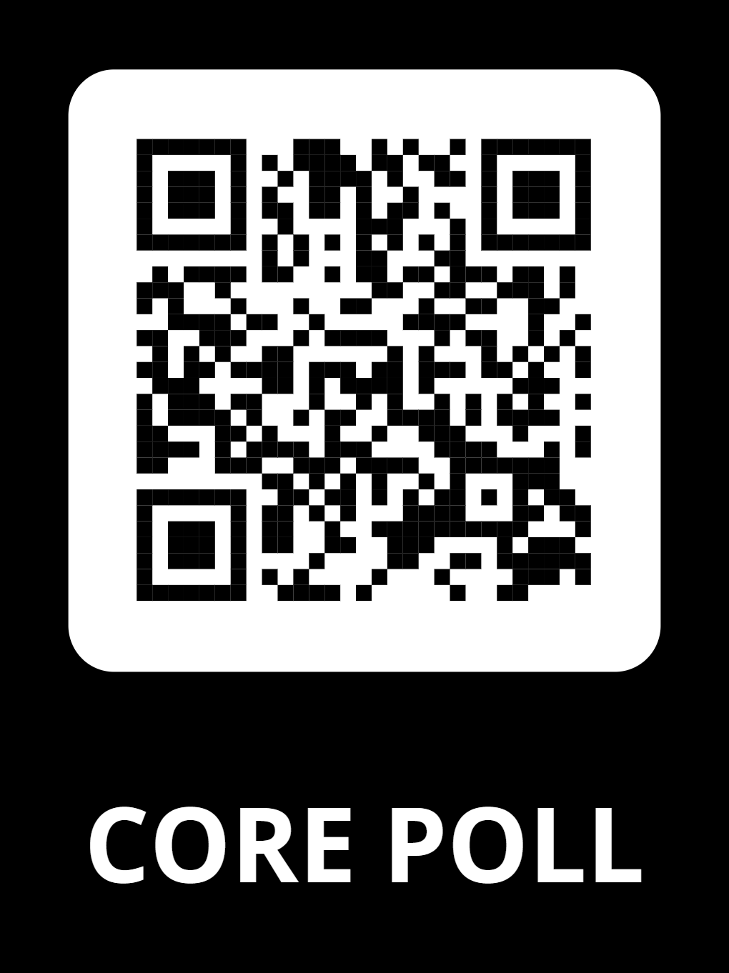
How Today Works
On your phone or tablet, open your browser.
Go to: https://www.menti.com/altpkx765s51
Enter the code displayed on the screen.(You’ll see the code at the top of each slide.)
Code: 8388 5086
Answer the questions that appear on your device.
Watch your answers—and everyone else’s—appear live on screen.
Polls and activities will appear on your device
Speak up during discussions – your voice matters!

Slide 22
The following surveys are part of the CORE Program. It should take about 5–10 minutes to complete. Please answer honestly based on your own experience.
Select the option that best fits your answer for each question.
For questions with multiple options, you can select all that apply.
If you choose “Other,” please type your answer in the space provided.
Survey 1: About You (Demographics)
This quick survey helps us understand who is participating in the CORE Program. Please answer honestly—your responses are confidential.
Survey 2: Your CORE Program Experience
Tell us about your experience with the CORE Program. Your feedback helps us improve services and support.
Survey 3: Challenges & Support
Help us learn what barriers you’ve faced and what support has helped—or what’s still missing.

Slide 23
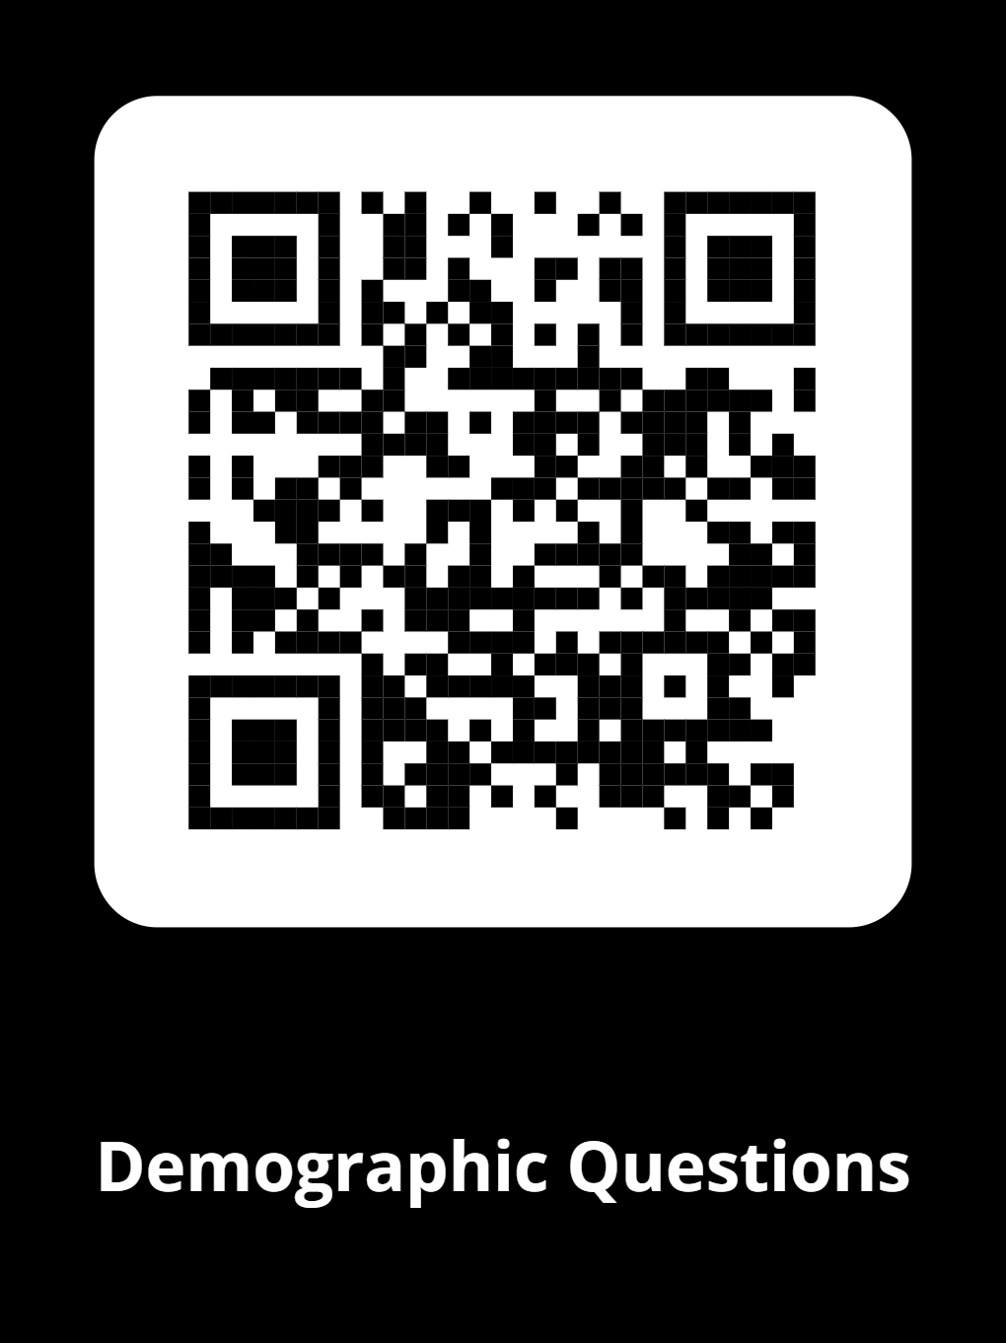
Demographic Survey
Survey 1: About You (Demographics)
This quick survey helps us understand who is participating in the CORE Program. Please answer honestly—your responses are confidential.
✔️ Takes 2–3 minutes.
✔️ One answer per question.
✔️ No personal details will be shared.

Slide 24
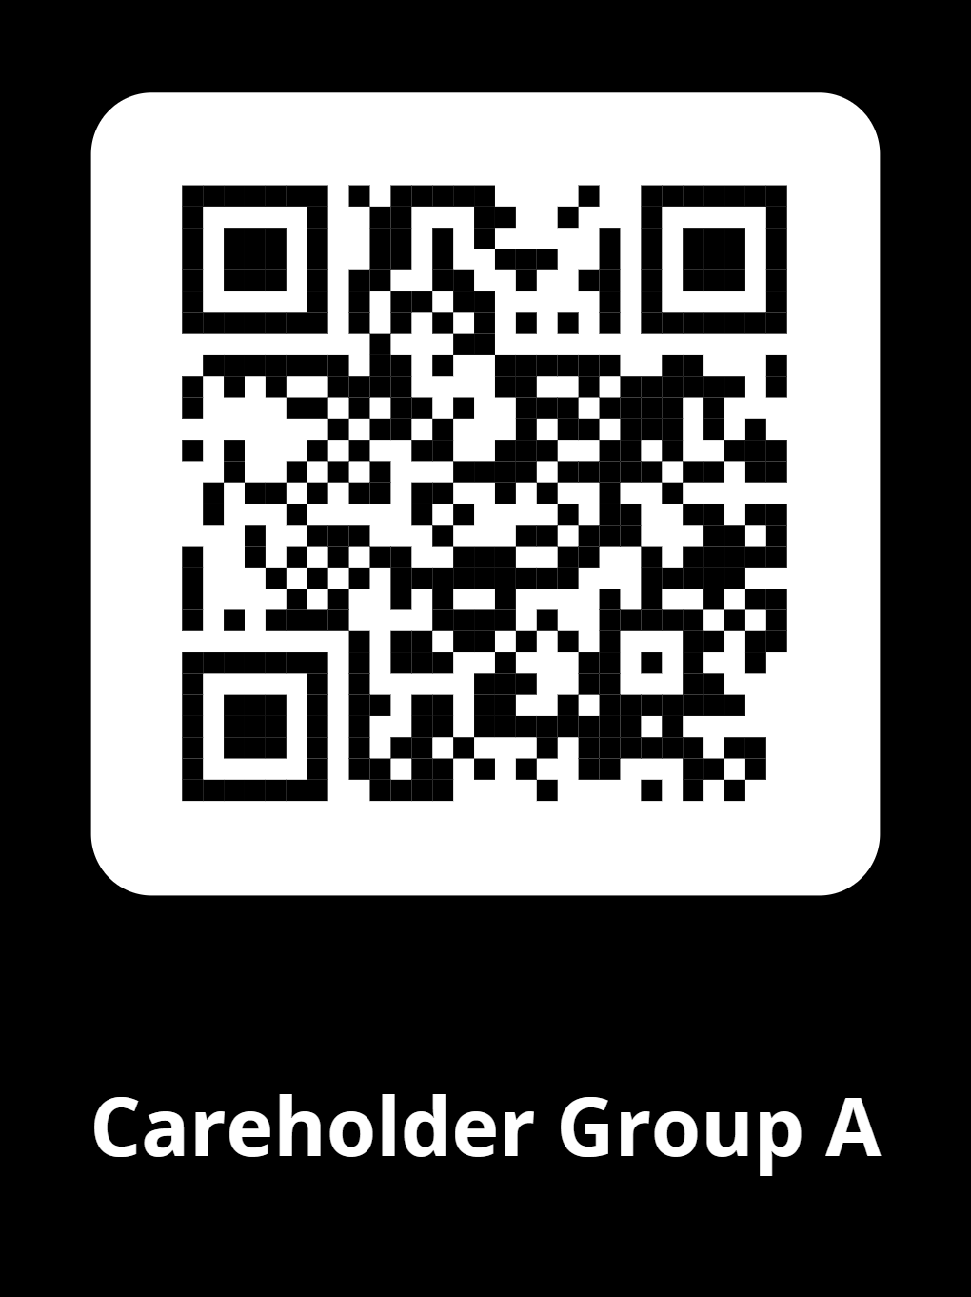
Careholder Group A: CORE Participants and Equity Applicants
Survey 2: Your CORE Program Experience
Tell us about your experience with the CORE Program. Your feedback helps us improve services and support.
✔️ Takes about 5–7 minutes.
✔️ Some questions let you select more than one answer.
✔️ Answer based on your real experience.

Slide 25
Thank You!
If you have any questions, please contact Dr. Ayoka Nurse @ drayokanurse@gmail.com

Slide 26
Launch Industries
Notes:
AL

Slide 27

Direct Technical Assistance
Local and state application, licensing, and regulatory fees
Legal assistance
Regulatory compliance
Request Assistance: https://launchmycannabiz.com/sacramento-core

Slide 28



Contact
Phone: (916) 808-8955 Web: https://www.cityofsacramento.gov/city-manager/cannabis-management
Email: cannabis@cityofsacramento.org

