Slide 1

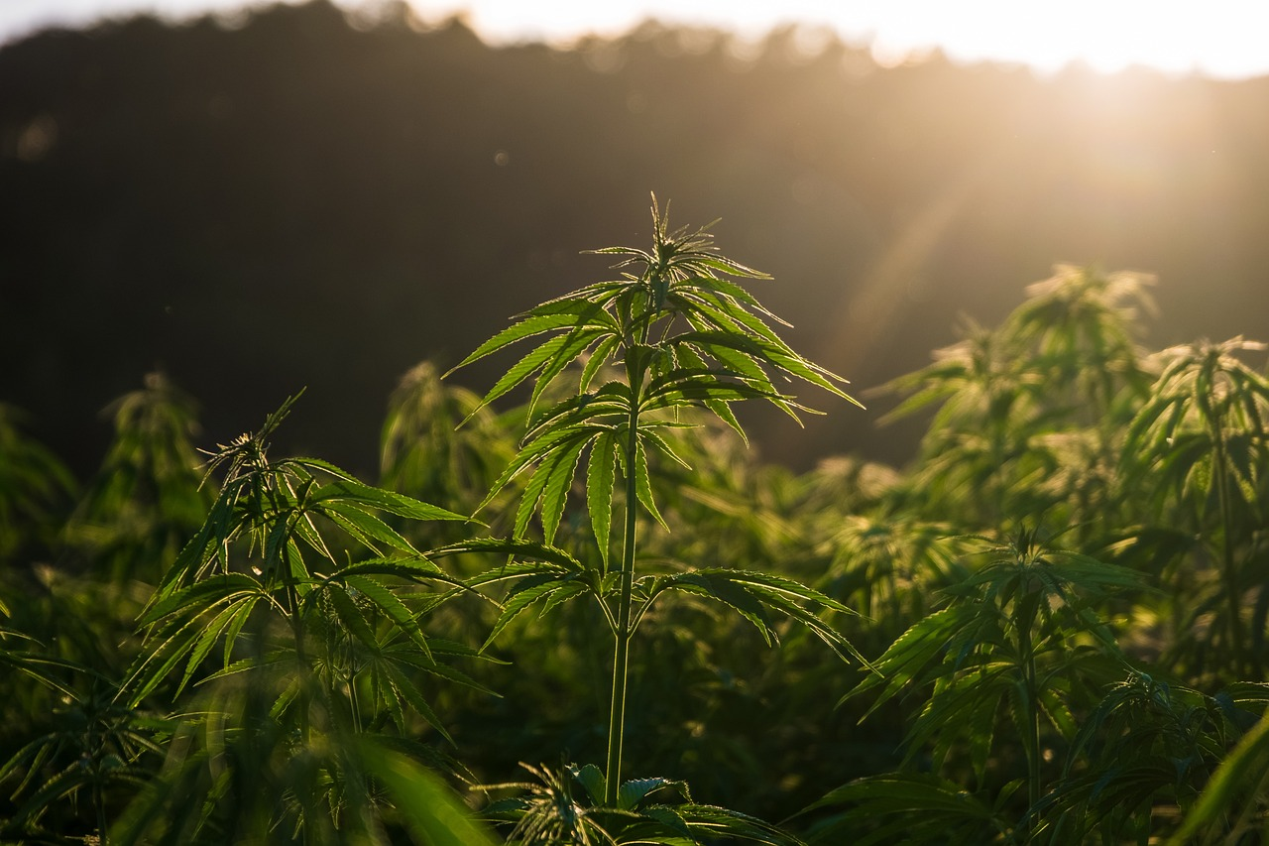
Prepared by the Office of Cannabis Management
July 25, 2024, 3:00pm-5:00pm
Cannabis Stakeholder Meeting

Slide 2
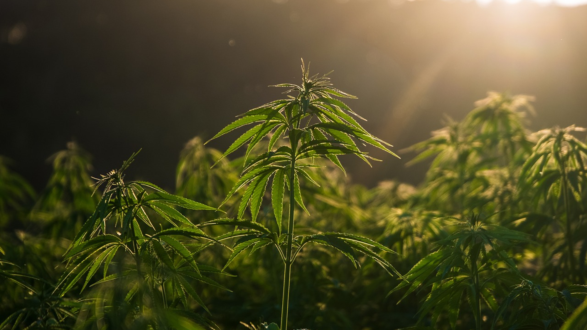
Meeting Expectations
Questions will be taken at the end of the presentation.
To ask a question, use the "raise hand" feature in Zoom, and we will call on you and ask you to unmute yourself.
We'll call on those who haven't spoken, and then, if time allows, call on those who have spoken.
Please be concise and civil in your comments.
We have a hard stop at 5 p.m., so if we're not able to get to your question or comment, you can email it or you can set up a self-scheduled meeting.
If you must leave early, meeting recordings and materials are put on our website within 72 hours.

Slide 3
Changes in Personnel and Phone Hours
OCM is short on staff, with three vacancies.
Davina is no longer with OCM.
Sgt. Vu is taking over the duties of reviewing the security plan and walk-throughs.
New Phone Hours: 8:00 a.m. to 4:00 p.m.
Same Email Response Hours: 8:00 a.m. to 5:00 p.m.

Slide 4
Business Operating Permit Numbers
Business Type | Citywide Total
 | Total | Issued | Pending | CORE
 |  |  |  | Issued | Pending
Cultivation | 117 | 103 | 14 | 7 | 0
Cultivation-Nursery | 16 | 15 | 1 | 2 | 0
Delivery Only | 59 | 42 | 17 | 13 | 6
Distribution | 51 | 39 | 12 | 5 | 1
Distribution-Transport Only | 1 | 1 | 0 | 0 | 0
Manufacturing | 28 | 20 | 8 | 3 | 2
Manufacturing-Shared | 4 | 4 | 0 | 4 | 0
Manufacturing-Small | 8 | 8 | 0 | 2 | 0
Microbusiness | 15 | 11 | 4 | 2 | 1
Microbusiness-Delivery | 2 | 0 | 2 | 0 | 1
Storefront Dispensary | 31 | 28 | 3 | 4 | 1
Storefront Dispensary-Delivery | 9 | 9 | 0 | 2 | 0
Testing Lab | 4 | 3 | 1 | 0 | 1
Totals: | 345 | 283 | 62 | 44 | 13

Slide 5
New Labor Peace Agreement Requirement
The new LPA requirements changed from 20 employees to 10 employees.
The applicant needs to update their LPAs when they renew their state license.
If the applicant renews their state license before their BOP renewal, OCM will take the new LPA if they renew their state license. After the BOP renewal, OCM will accept the old LPA.

Slide 6
BOP Renewal Timelines
Renewal reminders sent to email addresses in Accela 90-, 60-, 30-, 7- and 1-day before BOP expiration
Renewal application, renewal fee and all required renewal documentation due 30 days prior to expiration (SCC 5.150.230(E))
BOP expires and business MUST cease operation on expiration date listed on face of BOP, unless late fee is paid to provide an extension
If late fee is paid, applicant has 30 days from expiration to provide ALL complete, correct, and current documentation needed to approve renewal
During late fee extension period, failure to respond to OCM document requests within 24 hours will result in a referral to Code Enforcement
If renewal cannot be approved with file documentation at the end of 30-day extension, permit renewal will be denied

Slide 7
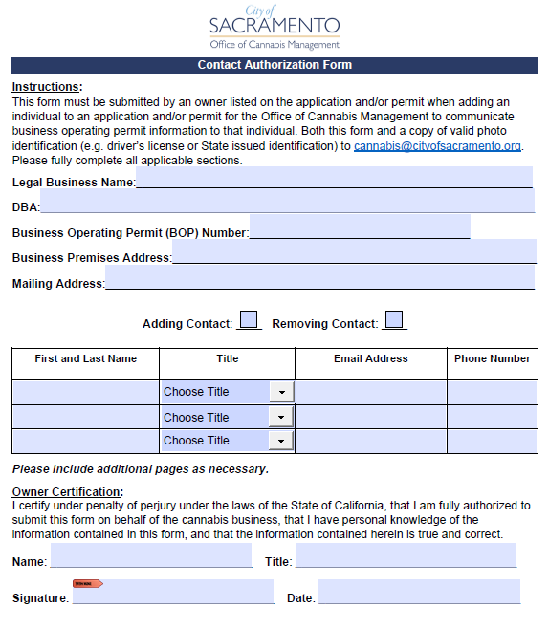
Contact Authorization Policy
An owner listed on the application and/or permit must fill out and sign the OCM Contact Authorization form located on our website and submit a copy of the form, and a copy of valid photo identification (e.g. drivers license or State issued identification) to cannabis@cityofsacramento.org.

Slide 8
Recruitment for DCC Cannabis Advisory Committee (CAC)
Applicants must submit a completed CAC application form and resume to CAC@cannabis.ca.gov by July 31, 2024.
CAC advises the DCC on the development of standards and regulations for commercial cannabis businesses, within the authority provided through Business and Professions Code, Division 10.

Slide 9
Upcoming Committee Meetings
Additional CORE Storefront Permits
  Law and Legislation – August 20, 2024
Consumption Lounges (anticipated timeline)
  Law and Legislation – September 17, 2024
  Law and Legislation – October 15, 2024
  City Council – November/December 2024
  Consumption Lounges – Spring 2025

Slide 10



OCM Contact
Phone: (916) 808-8955
Web: https://www.cityofsacramento.gov/city-manager/cannabis-management
Email: cannabis@cityofsacramento.org

