Slide 1


Prepared by the Office of Cannabis Management
CORE Stakeholders Meeting 3:00pm-5:00pm
May 23, 2024
CORE Stakeholder Meeting

Slide 2


Stakeholder Meeting Ground Rules
Questions will be taken at the end of the presentation
To ask a question, use the "Raise Hand" function in Zoom
People will be asked to unmute themselves and ask their question in the order that we see their hand icon
We will call on everyone who hasn't asked a question before we call on those who have already spoken
Please be civil and brief in your questions as we have a hard stop at 5pm and we try to take as many questions as we can in that time

Slide 3
CORE Business Operating Permits
Business Type | Citywide Total
 | Total | Issued | Pending | CORE
 |  |  |  | Issued | Pending
Cultivation | 117 | 103 | 14 | 7 | 0
Cultivation-Nursery | 16 | 15 | 1 | 2 | 0
Delivery Only | 63 | 47 | 16 | 12 | 6
Distribution | 52 | 39 | 13 | 5 | 1
Distribution-Transport Only | 1 | 1 | 0 | 0 | 0
Manufacturing | 28 | 20 | 8 | 3 | 2
Manufacturing-Shared | 4 | 4 | 0 | 4 | 0
Manufacturing-Small | 11 | 10 | 1 | 2 | 0
Microbusiness | 15 | 11 | 4 | 2 | 1
Microbusiness-Delivery | 2 | 0 | 2 | 0 | 1
Storefront Dispensary | 31 | 27 | 4 | 4 | 1
Storefront Dispensary-Delivery | 9 | 9 | 0 | 2 | 0
Testing Lab | 4 | 3 | 1 | 0 | 1
Totals: | 353 | 289 | 64 | 43 | 13

Slide 4
Law & Legislation 5/21/24 Meeting:
Consumption Lounge and Planning Presentation
OCM and Planning gave presentations on workplans for cannabis zoning and sensitive uses, and a draft workplan for cannabis consumption lounges
OCM's presentation indicated that we are looking at two possible storefront retailer add-on licenses
  Type 1 – Ingestible only
  Type 2 – Inhalable and Ingestible

Slide 5
Law & Legislation 5/21/24 Meeting:
Consumption Lounge Draft Framework
Type 1 permits to be open to all storefront retailers with no additional ventilation, but adhere to all Planning and OCM requirements
Type 2 permits to be available to CORE storefronts only for 5 years and require ventilation and air exchange standards, in addition to Planning and OCM requirements
  5 years would allow CORE businesses to acquire funding, install ventilation systems, and become operational before Council could decide to open Type 2 permits to all
Majority of Committee not in favor of CORE exclusivity

Slide 6
Law & Legislation 5/21/24 Meeting:
"Stand Alone" Consumption Lounges Not Possible
Business & Professions Code §26200(g): "Notwithstanding paragraph (1) of subdivision (a) of Section 11362.3 of the Health and Safety Code, a local jurisdiction may allow for the smoking, vaporizing, and ingesting of cannabis or cannabis products on the premises of a retailer or microbusiness licensed under this division if all of the following are met..."
Business & Professions Code §26001(at): “Premises” means the designated structure or structures and land specified in the application that is owned, leased, or otherwise held under the control of the applicant or licensee where the commercial cannabis activity will be or is conducted. The premises shall be a contiguous area and shall only be occupied by one licensee.
4 CCR §15414: (c) A non-storefront retailer licensee shall comply with all the requirements applicable to retailer licensees, except for those provisions related to public access to the licensed premises and the retail area. (d) The licensed premises of a non-storefront retailer licensee shall be closed to the public.

Slide 7
Additional CORE Storefront Permits Timeline
Scoring rubric in development for qualified lottery option preferred by majority of respondents
Expect a survey to gather input on scoring rubric
Intend to bring to Law and Legislation Committee August 2024
  OCM's work priority per Council:
    Additional Storefronts
    Consumption Lounges
    Events

Slide 8
California State Fair: Consumption & Sales Event
OCM granted a request for local authorization for a sales and consumption event at the California State Fair (7/12-28) at Cal Expo by event organizer Embarc Events, LLC.
  Embarc Events, LLC has stated that Embarc Sacramento, a majority CORE-owned storefront, will be the sole cannabis retailer at the event

Slide 9
End of Security Rebates
Due to funding restrictions, security rebates are no longer available
If you have an in-process security rebate, OCM will continue to process those applications while we can

Slide 10
Labor Peace Agreements: Changing July 1
As of July 1, 2024, state cannabis license applicants and licensees with ten or more non-supervisory employees will be required to enter into and abide by Labor Peace Agreements
  https://cannabis.ca.gov/labor-peace-agreements-for-cannabis-businesses/
Unchanged: Requirement that employers with two or more employees have one supervisor and one employee successfully complete a Cal/OSHA 30-hour general industry outreach training course offered by a training provider that is authorized by an OSHA Training Institute Education Center.

Slide 11

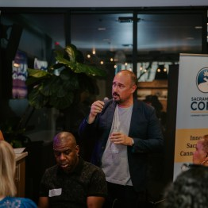
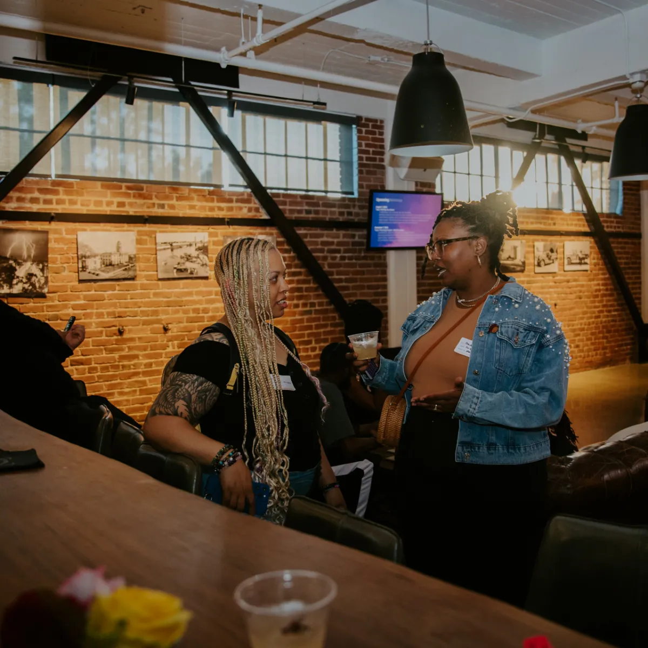


ENCORE Mixer
First ENCORE Mixer of 2024
Business readiness seminars with experts
Save the date for next ENCORE
August 1, 2024, 5:00-8:00 PM

Slide 12
CORE Tiered Grant Cycle 1 Update
39 Total Qualified Applicants
29 previous grantees
10 new applicants
OCM completed the review of applications. Next steps:
  Sign grant agreement
  Submit budget to Fiscal team for review
  Fund disbursement

Slide 13
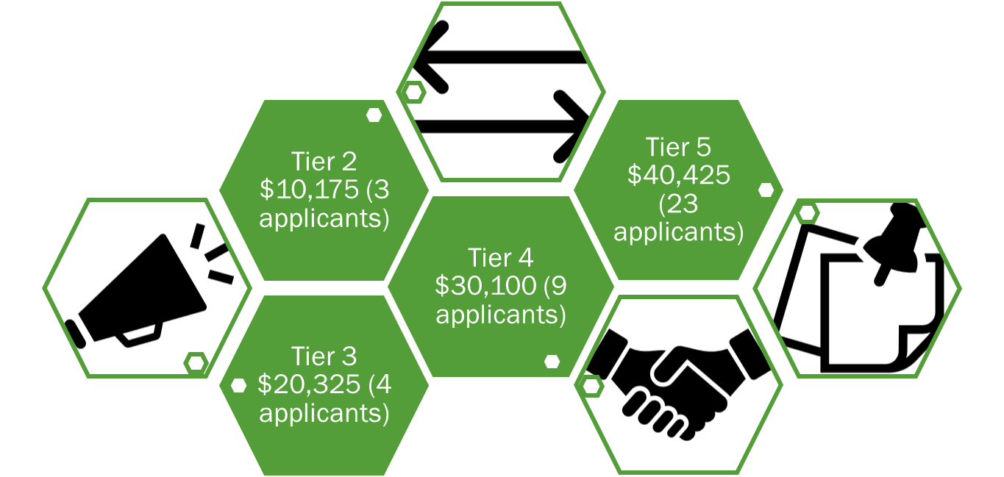
CORE Tiered Grant Cycle 1 Update
Total Award: $1,312,500
*No Tier 1 applications were received

Slide 14
CORE 2024 Tiered Grant Cycle 2
Grant Cycle 2 will be available in the late summer or early fall of 2024
Requirements to be eligible for Cycle 2 will be similar to this cycle
If you were not able to get your documentation in for Grant Cycle 1, please continue to gather your information so you're ready to apply for Grant Cycle 2

Slide 15
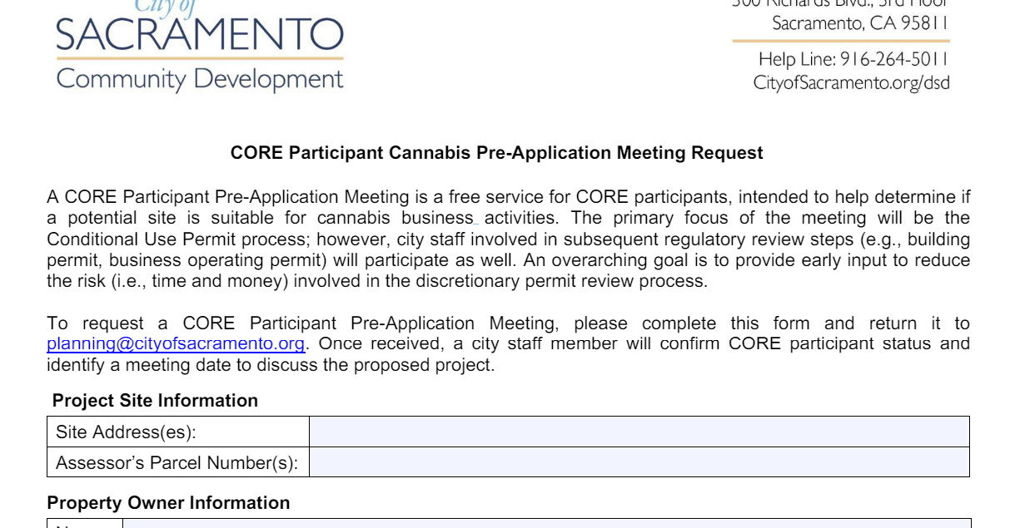
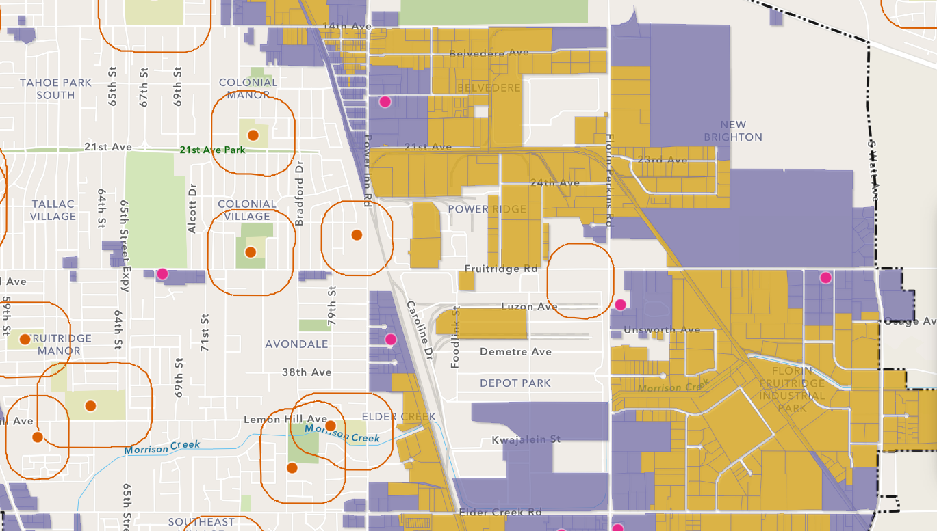
New CORE Benefit
CORE Participant Cannabis Pre-Application Meeting is:
  With Planning department and other departments involved in subsequent regulatory review steps (e.g., building permit, business operating permit)
  Intended to help determine if a potential site is suitable for cannabis business activities
  A free service
Business Map Viewer is
  A draft viewer can be used to research locations which may permit cannabis business operations

Slide 16
CORE Technical Assistance RFP Update
The Request for Proposal (RFP) is to provide technical assistance to CORE participants such as architecture and design services, marketing and branding services, regulatory compliance services, etc.
Closed on 5/15/24:
Received 9 proposals
Currently, OCM is reviewing the proposals

Slide 17

CORE Ambassador Program
OCM is seeking Ambassadors to represent the CORE Program at tabling events.
Apply here: https://uppercloud.typeform.com/to/ojBnRDu8

Slide 18



CORE Contact
Phone: (916) 808-8955
Web: SacramentoCore.org
Email: cannabis@cityofsacramento.org

